Slide 1
Android Training

Slide 2
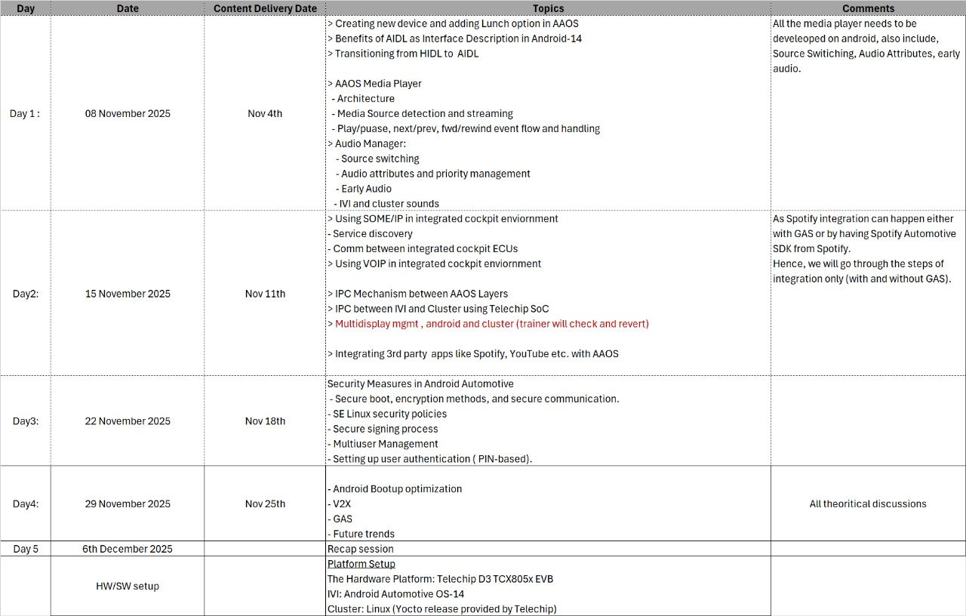

Slide 3
Android
Day#1 - Recap

Slide 4
Agenda
Recap session
Platform Setup
The Hardware Platform: Telechip D3 TCX805x EVB
IVI: Android Automotive OS-14
Cluster: Linux (Yocto release provided by Telechip)

Slide 5
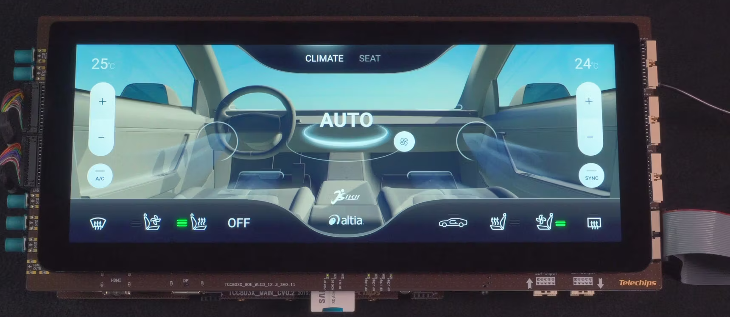

Slide 6
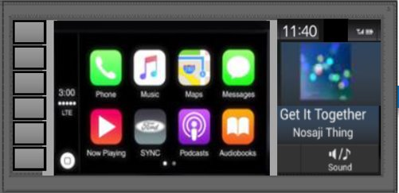
IVI
IVI (In-vehicle Infotainment) is a system that delivers a combination of information and entertainment content/services. Moreover, infotainment systems are in-built car computers that combine a wide range of functions – from digital radios to in-built reversing cameras.​
​
The IVI can be described as a combination of vehicle systems which are used to deliver entertainment and information to the driver and the passengers through audio/ video interfaces, control elements like touch screen displays, button panel, voice commands, and more.​
Notes:
Explain about IVI and some of its features and use cases etc..

Slide 7

IC
An instrument cluster is a board with several different gauges and warning lights mounted in it. The instrument cluster is mounted in the dashboard, just behind the steering wheel. The driver depends on the gauges and indicators to keep tabs on the vehicle’s status. Some of the most common gauges and indicators include:​
Speedometer​
Tachometer​
Fuel gauge​
Oil pressure gauge​
Odometer​
Turn signal indicators​
Notes:
Explain about IC and some of its features and use cases etc..

Slide 8
Telechip TCC805x Development Platform
TCC8050_53 Evaluation Board (EVB) is based on the TCC805x (Dolphin3) Processor family which is ideal (SoC) System on Chip, targeted at IVI/Cockpit and ADAS, TCC805x is based on Arm® Cortex®-A72 Quad core and Arm Cortex-A53 Quad core. It provides great performance of 2D/3D graphic engine for rich and vivid GUI with Imagination PowerVR series9XTP Core and supports HW Virtualization for Hypervisor-Less Cockpit (HLC) solution.
TCC805x supports not only multi-display and multi-channel camera input, but also embodies Image Signal Processing sub-system and MICOM sub-system that supports isolated safety island.
In addition, TCC805x can run operating systems such as Android™, Linux®, and QNX®.
Notes:
Explain What is SoM, What is SoC, What is EVK, What is production board

Slide 9
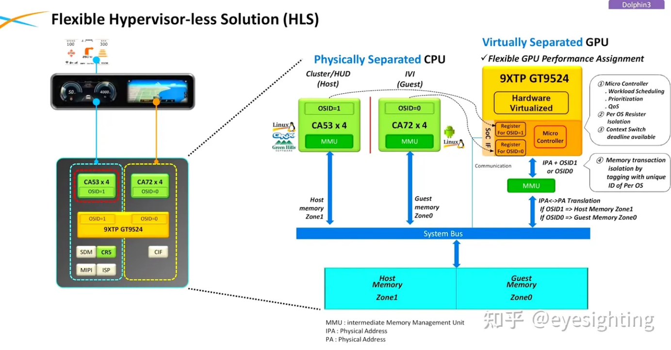
Hypervisor-less Solutions
Notes:
Explain What is Maincore, Subcore etc..

Slide 10
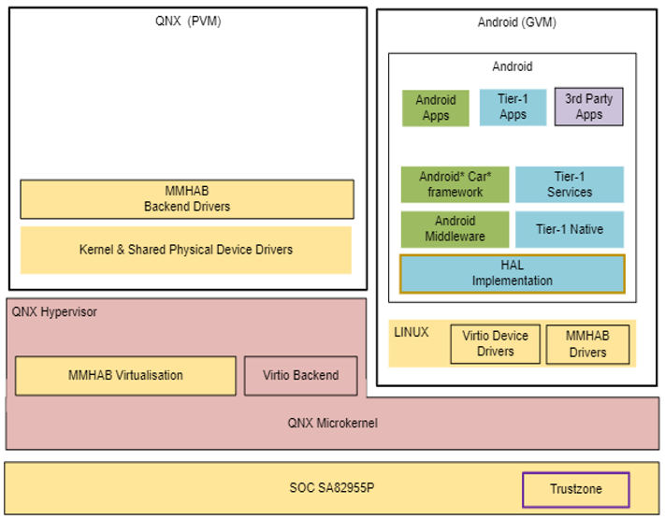
Qualcomm SA82955 Development Platform
Notes:
Explain What is Hypervisor

Slide 11
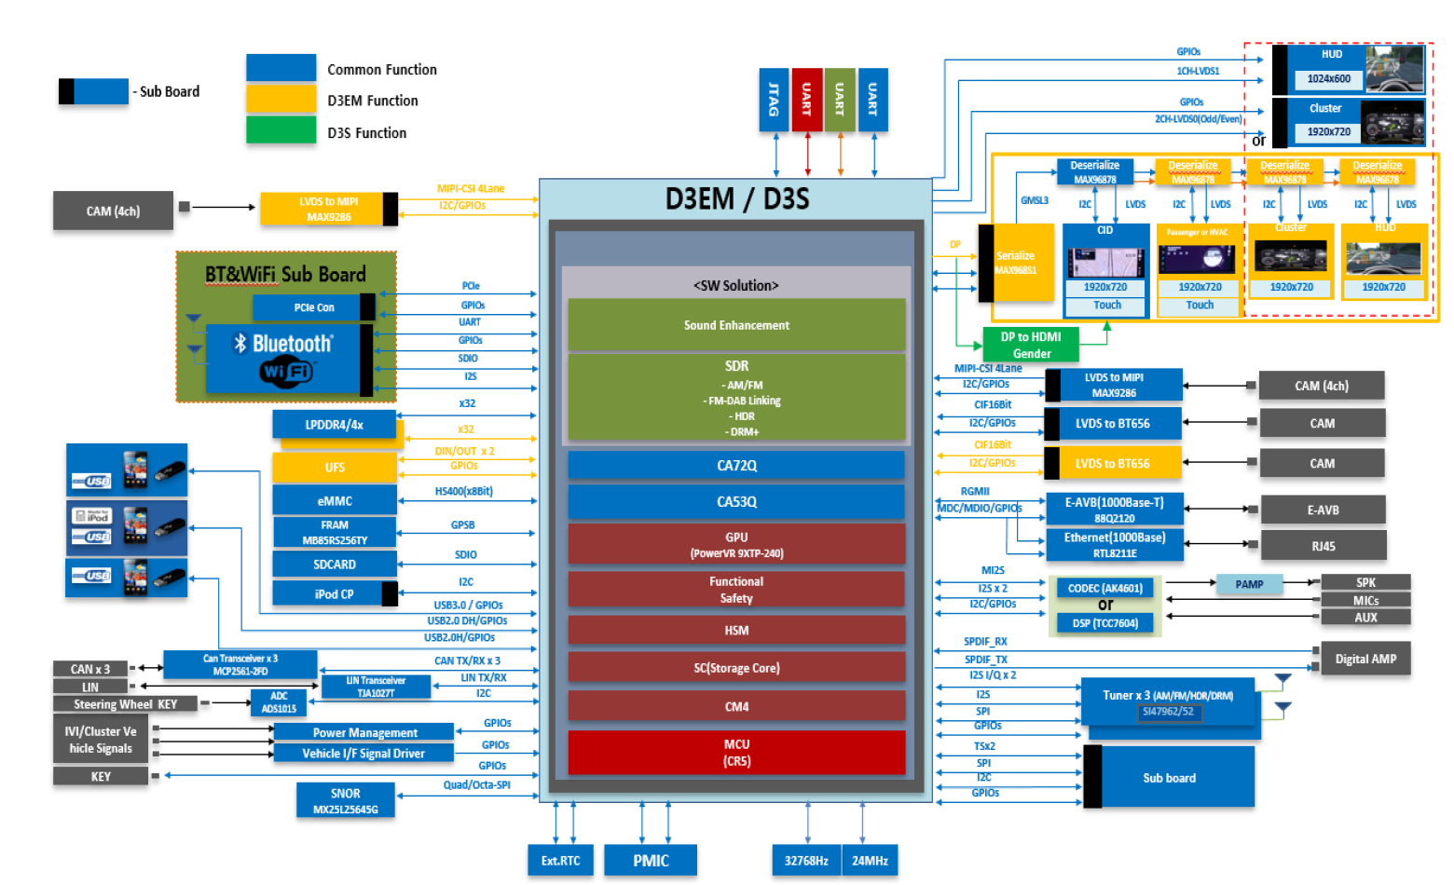
Telechip TCC805x Development Platform
Notes:
TCC8050_53 Evaluation Board (EVB) is based on the TCC805x (Dolphin3) Processor family with the combination of various sub-board connected through various interface buses such as UART, I2C, SPI, LVDS, I2S, SDIO, CAN, USB etc.
TCC8050_53 EVB can implement the following functions depending on the combination of various sub-board.
ΙςΙ Σψστεμ
Φυλλ Διγιταλ Χλυστερ
ΙςΙ ανδ Φυλλ Διγιταλ Χλυστερ ανδ Ηεαδ Υπ Δισπλαψ (ΗΥΔ) − Χοχκπιτ σψστεμ
Συρρουνδ ςιεω Μονιτορ (ΣςΜ)
ΜΙΠΙ Ιντερφαχε
ΠΧΙε Ιντερφαχε
ιΠοδ Ιντερφαχε

Slide 12
Day 1 Agenda
Introduction to Android
Android Version and History
Android Eco-system
Android Components
Installation of Android Studio - setup Environment - SDK - Emulator
Android Architecture
Language used for Development
Android Application Development - Basic Components
Android AOSP Folder Structure and Important Modules
Android Build System
Android Advance topics
Introduction to Android Automotive
Overview of Android Automotive
History, evolution, and key features.
Android Automotive vs. Android Auto.
Overview of Android Automotive OS vs. Android Auto.
Core differences, use cases, and market adoption.
Architecture of Android Automotive OS
Core Components and Layers
Practical Session =>
Setting Up Android Automotive Environment on Laptop
Configuring and exploring the Android Automotive environment.
Downloading and flashing Android Automotive for Telechips HW.
Set up the Android Automotive environment on Telechips and explore its features
Device Configuration and Build option

Slide 13
A few things to keep in mind:
There isn't a single human being that understands all of Android
Even within the "Android team(s)", very specialized know-how
Despite years of work on this, I'm still learning
Use source.android.com ("official" internals "book“ for Android)
To learn Android Seek people that share their know-how
Notes:
1. Go to Link -> https://source.android.com/docs/core/architecture and Explain how Andorid is available for Watch, Phone, TV, CAR, etc etc… 2. Go to Link -> https://source.android.com/docs/core and explain how Andorid has various subsystem such as USB, storage etc…

Slide 14
From where to learn Android ?
https://source.android.com/
Notes:
https://source.android.com/ Explain and show about doc and code search feature etc..

Slide 15
Introduction to Android
Android is an operating system based on Linux, specifically developed for mobile devices such as cell-phones and tablets.
includes all the frameworks and that let you create and deploy your own custom applications
Andy Rubin is the founder of Android Inc. and developed the Android Operating system in 2003.
In 2005 Google acquired the Android operating system from Android Inc
Currently Google is Developing and Maintaining the Android
The android operating system is used on more than 3 billion active devices across the globe
Notes:
Go to link -> https://source.android.com/docs/setup/about

Slide 16
Timeline History
2002:
Sergey Brin and Larry Page started using
Sidekick smartphone
Sidekick one of 1st smartphones integrating
web, IM, mail, etc.
Sidekick was made by Danger inc., cofounded
by Andy Rubin (CEO)
Brin/Page met Rubin at Stanford talk on
Sidekick’s development
Google was default search engine on Sidekick
2004:
Despite cult following, Sidekick wasn’t
making $
Danger inc. board decided to replace Rubin
Rubin left. Got seed $. Started Android inc.
Started looking for VCs.
Goal: Open mobile hand-set platform
2005 - July:
Got bought by Google for ~50M$
2007 - November:
Open Handset Alliance announced along with
Android

Slide 17
Android Version and History
2008 – Sept.: Android 1.0 is released
2009 – Feb.: Android 1.1
2009 – Apr.: Android 1.5 / Cupcake
2009 – Sept.: Android 1.6 / Donut
2009 – Oct.: Android 2.0/2.1 / Eclair
2010 – May: Android 2.2 / Froyo
2010 – Dec.: Android 2.3 / Gingerbread
2011 – Jan : Android 3.0 / Honeycomb – Tablet Optimized
2011 – May: Android 3.1 – USB host support
2011 – Nov: Android 4.0 / Ice-Cream Sandwich –merge Gingerbread and Honeycomb
2012 – Jun: Android 4.1 / Jelly Bean – Platform Optimization

Slide 18
Android Version and History
2012 – Nov: Android 4.2 / Jelly Bean – Multiuser support
2013 – July: Android 4.3 / Jelly Bean -- BLE /GLES 3.0
2013 – Oct: Android 4.4 / KitKat -- Low RAM optimizations
2014 – Nov: Android 5.0 / Lollipop - ART and other pixie dust
2015 – Mar: Android 5.1 / Lollipop - Multi-SIM card
2015 – Oct: Android 6.0 / Marshmallow – New permission model
2016 – Aug: Android 7.0 / Nougat – Multiwindow
2016 – Oct: Android 7.1 / Nougat – A/B updates
2017 – Aug: Android 8.0 / Oreo – Treble / PIP
2017 – Dec: Android 8.1 / Oreo – Low-end device optimizations
2018 – Aug: Android 9.0 / Pie – AI, multicamera API, indoor wifi positioning
2019 – Aug: Android 10.0 / "No name" – Apex
2020 – Sept: Android 11.0 – Generic Kernel Image
2021 – Oct: Android 12.0 – CrosVM
2022 – Aug: Android 13.0 – Kleaf kernel build

Slide 19
Android Version and History
The android version names starts English alphabets and with sweet names, to identify the name they give API levels.
Every Year Google Releases new version with new features, bug fixes & Security patches
Each release information and details we can see in Google Website
Currently Latest Version is Android 15
Notes:
NOTE – Explain Whenever Android Release it releases for all the flavours means for - Phone
Tablet
Wear (watches)
TV
Car:
"Auto"
"Automotive"

Slide 20
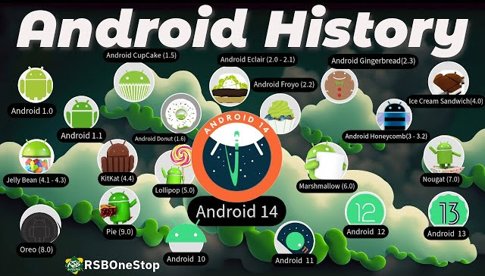
Android Version and History

Slide 21
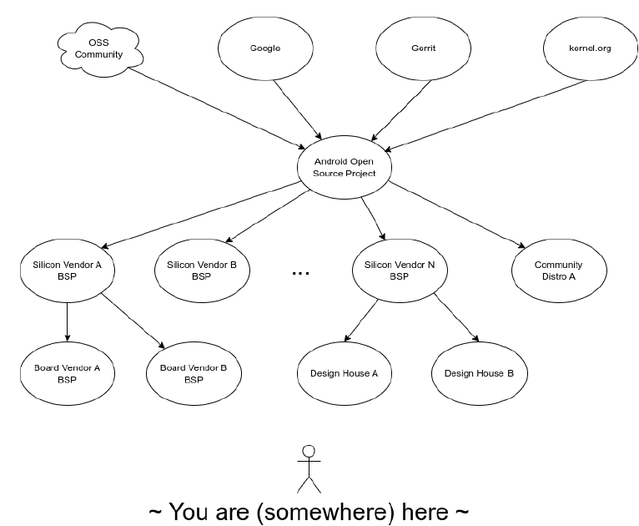
Android Open-Source Project Ecosystem Flow
Notes:
Explain How Android Release Work and How we get the android Google -> Telechip (SoC vendor) -> Forvia (Telechip based Board) -> Client for e.g. VW

Slide 22
As a AOSP, BSP developer how it matters to me
Post shipping considerations: what now?
How long will Google support this AOSP?
How long will my SoC vendor povide updates?
How long is my kernel supported for?
What about OTA / Upgrade?
Mechanism
Backend
Fallback
What about runtime device monitoring?
What about device provisioning?
etc.?

Slide 23
Android Eco-system
Android Ecosystem key components are,
Android OS & Regular Updates
Google Services and Apps
Android app development
Customization and ecosystem Integration
Security and Privacy
Google Devices (in next slide)

Slide 24
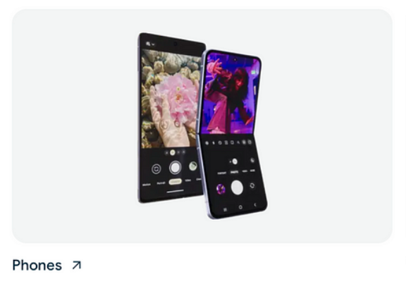
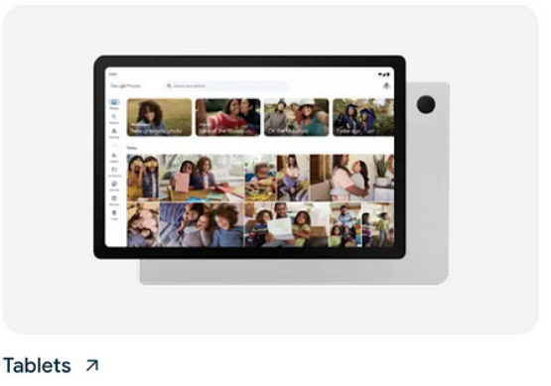
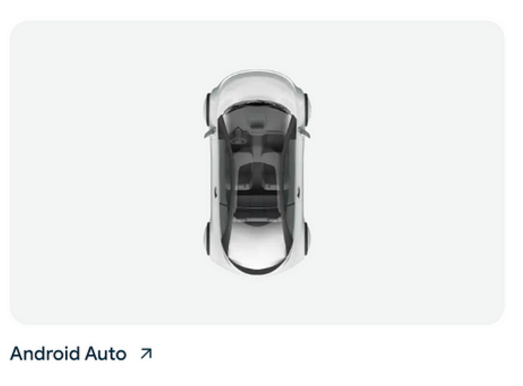
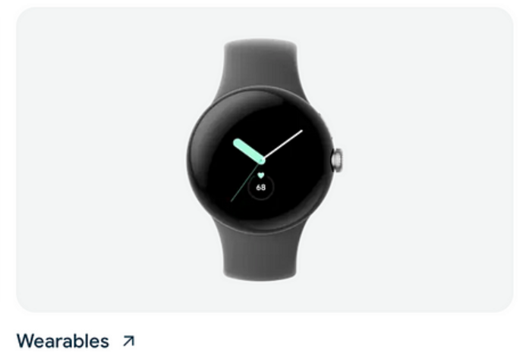
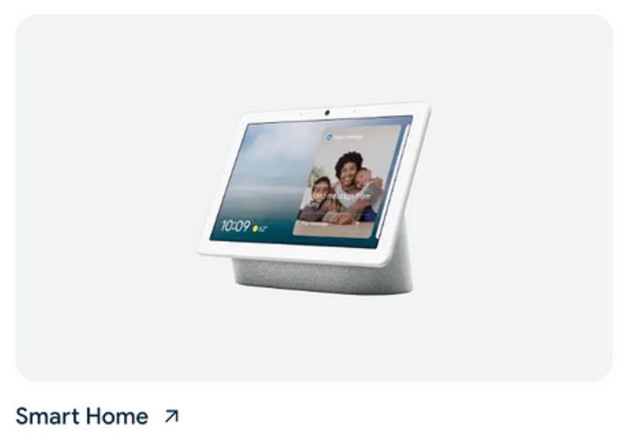
Android Eco-system
First Android Phone is HTC Dream (T-Mobile G1) developed in September 2008
First Android Tablet is Archos 5 Internet Tablet introduced in September 2009
First Android Automotive is Car Audi A8 introduced in 2011
The First Android Watch is LG G Watch in July 2014
The First Smart Home/TV is Nexus Player 2014

Slide 25
Android Download and Build
https://source.android.com/docs/setup/download
Get "repo":
Fetch the AOSP:
Make sure you fetch a tagged release, say 13.0:
http://android.googlesource.com/
$ curl https://storage.googleapis.com/git-repo-downloads/repo > ~
$ chmod a+x ~/bin/repo
$ repo init -u https://android.googlesource.com/platform/manifest
> -b android13-gsi
$ repo sync
Notes:
Explain – Required packages for various Ubuntu version, repo commands etc… go to -> https://cs.android.com/android/platform/superproject/main explain about all the files and folder of android explain about repo, explain about git, explain about gerrit and explain about manifest files.
NOTE => Show .repo folder and explain manifest files…. Can be done in last also when we start showing telechip source code download and build steps…

Slide 26
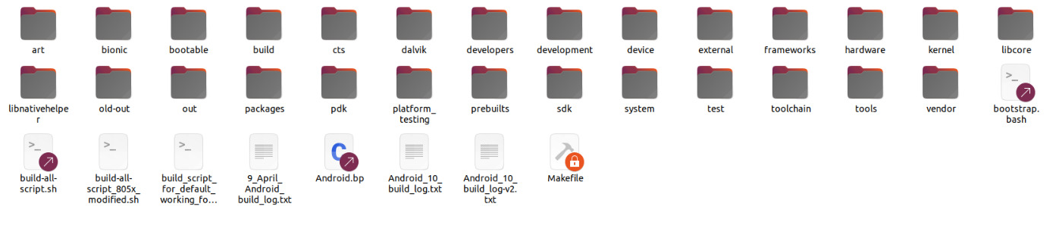
Telechip Android 10 folder Structure

Slide 27
Android Directory Structure
Directory | Description
art | Android Runtime
bionic | Android’s Implementation of C library. (it’s LibC library’s replacement)
bootable | OTA and update tools (bootloader, diskinstaller, recovery)
buid | The main entry point of the android build system
cts | Compatibility Test Suite
dalvik | Dalvik VM, Delvik tools and Core libraries
development | Development tools, Platform engineering tools and sample apps
device | Device-specific files and components
external | Copy of external projects used by AOSP
Notes:
go to -> https://cs.android.com/android/platform/superproject/main explain about all the files and folder of android explain about repo, explain about git, explain about gerrit and explain about manifest files.
Show .repo folder and explain manifest files…. art : Android runtime environment. All the ART related modules can be found here including dex compiler, JVM, dalvikVM, etc.
bionic : Amdroid’s custom C library. Bionic is android’s C library, math library and dynamic linker.
bootable : Boot related code. Contains bootloader, OTA, recovery mechanism.
build : Build system. You can find envsetup.sh, common shell scripts and make, soong folder here.
cts : CTS is Android’s (Compatibility Test Suite Standard).
dalvik : Dalvik virtual machine related code, even though art was introduced. Android still used the dex code. In this folder, there are modules supporting dex code generator and Dalvik exchange.
developers : Developers directory contains demo and sample android projects.
development : Application development related. here you can find the development IDE like clion, eclipse, intellij under the ide folder. Lots of sample implementation under samples folder. And many other folders as well.
device : Device specific files and components. Here we can find the supporting config and driver files required for development boards like linaro hikey, ti, amlogic, etc.
external : External open source project imported into the AOSP. This folder contains a lot of dependent projects used by AOSP like Dagger2, exoplayer, flatbuffers, icu, jackson, rust and many other. There are around 347 dependent modules in it as in AOSP 12.
frameworks : Application framework. The code part of the android system written in Java and C++. Here we can find all the system services and core implementations of android. As mentioned, It is the place where most API’s are defined. /frameworks/base/core/java/android/app /frameworks/base/core/java/android/content /frameworks/base/services/core/java contains most system services, and these directories typically have more granularity than /core/java/ Since they can be refactored without top layer API changes.
hardware : Mainly the code of the hardware abstraction layre and hardware support modules, consist of HAL for audio, video, usb, tv, camera, etc.
kernel : Contains kernel configs, prebuilts.
libcore : Consist of many core libraries related json, xmlparser, apache harmony, etc.
libnative helper : Dynamic library. the basis of JNI library. It consist of helper functions to use with JNI.
out : After the build completes, the code output is in this directory. You can find the generated images for the build here.
packages : Application package like stock android apps, providers, IMF’s and many more.
pdk : Platform development kit. PDK is a reduced set of android release provided to chipset vendors and OEM’s before a new android platform is released. The goal of the PDK release is to help chipset vendors and OEM’s to migrate to a new release. PDK release includes only necessary components for developing android HAL (Hardware Abstraction Layer). Note full android release is a superset of PDK release.
platform_testing : Platform test, consist of platform test modules.
prebuilts : Consist of prebuilt binaries. Includes toolchains like asuite, android emulator, bazel, etc.
sdk : Many SDK tools sources can be found here. Instructions to build sdk for a specific build can be found here under docs.
system : It contains low level file system libraries, application and components. This is the “Embedded Linux” folder. Here you can find folders for SELinux, Logging, Libhidl and many low level configurations.
test : Contains the test suites like csuite, catbox, vts (vendor test suite), mts (mainline test suite), etc.
toolchain : Toolchain files related to benchmark and pgoprofiles.
tools : Tools files like apksig, asuite, trade federation, etc.
Vendor : vendor folder is where device manufacturers and hardware vendors place their proprietary code, drivers, binaries, hardware abstraction layers (HALs), and custom software that are not open source and are specific to their hardware

Slide 28
Android Directory Structure
Directory | Description
framework | System services, android. *, Android-related cmds, etc.
hardware | Hardware support libs, HAL, HIDL
libcore | Test code for dalvik, DOM, JSON, and other support files Apache Harmony
ndk | Build scripts & helper files for building the NDK
packages | Stock Android apps, providers, etc.
prebuilt | Prebuilt binaries, cross compilations toolchains for different development machines
sdk | The SDK
system | System core files (commands, debugging, bootstat)
out | Build generated directory, output is placed here
Notes:
go to -> https://cs.android.com/android/platform/superproject/main explain about all the files and folder of android explain about repo, explain about git, explain about gerrit and explain about manifest files.
Show .repo folder and explain manifest files…. art : Android runtime environment. All the ART related modules can be found here including dex compiler, JVM, dalvikVM, etc.
bionic : Amdroid’s custom C library. Bionic is android’s C library, math library and dynamic linker.
bootable : Boot related code. Contains bootloader, OTA, recovery mechanism.
build : Build system. You can find envsetup.sh, common shell scripts and make, soong folder here.
cts : CTS is Android’s (Compatibility Test Suite Standard).
dalvik : Dalvik virtual machine related code, even though art was introduced. Android still used the dex code. In this folder, there are modules supporting dex code generator and Dalvik exchange.
developers : Developers directory contains demo and sample android projects.
development : Application development related. here you can find the development IDE like clion, eclipse, intellij under the ide folder. Lots of sample implementation under samples folder. And many other folders as well.
device : Device specific files and components. Here we can find the supporting config and driver files required for development boards like linaro hikey, ti, amlogic, etc.
external : External open source project imported into the AOSP. This folder contains a lot of dependent projects used by AOSP like Dagger2, exoplayer, flatbuffers, icu, jackson, rust and many other. There are around 347 dependent modules in it as in AOSP 12.
frameworks : Application framework. The code part of the android system written in Java and C++. Here we can find all the system services and core implementations of android. As mentioned, It is the place where most API’s are defined. /frameworks/base/core/java/android/app /frameworks/base/core/java/android/content /frameworks/base/services/core/java contains most system services, and these directories typically have more granularity than /core/java/ Since they can be refactored without top layer API changes.
hardware : Mainly the code of the hardware abstraction layre and hardware support modules, consist of HAL for audio, video, usb, tv, camera, etc.
kernel : Contains kernel configs, prebuilts.
libcore : Consist of many core libraries related json, xmlparser, apache harmony, etc.
libnative helper : Dynamic library. the basis of JNI library. It consist of helper functions to use with JNI.
out : After the build completes, the code output is in this directory. You can find the generated images for the build here.
packages : Application package like stock android apps, providers, IMF’s and many more.
pdk : Platform development kit. PDK is a reduced set of android release provided to chipset vendors and OEM’s before a new android platform is released. The goal of the PDK release is to help chipset vendors and OEM’s to migrate to a new release. PDK release includes only necessary components for developing android HAL (Hardware Abstraction Layer). Note full android release is a superset of PDK release.
platform_testing : Platform test, consist of platform test modules.
prebuilts : Consist of prebuilt binaries. Includes toolchains like asuite, android emulator, bazel, etc.
sdk : Many SDK tools sources can be found here. Instructions to build sdk for a specific build can be found here under docs.
system : It contains low level file system libraries, application and components. This is the “Embedded Linux” folder. Here you can find folders for SELinux, Logging, Libhidl and many low level configurations.
test : Contains the test suites like csuite, catbox, vts (vendor test suite), mts (mainline test suite), etc.
toolchain : Toolchain files related to benchmark and pgoprofiles.
tools : Tools files like apksig, asuite, trade federation, etc.
Vendor : vendor folder is where device manufacturers and hardware vendors place their proprietary code, drivers, binaries, hardware abstraction layers (HALs), and custom software that are not open source and are specific to their hardware

Slide 29
Android Directory Structure
Set up build environment: $ . build/envsetup.sh
$ lunch
Build AOSP : $ make –j8
Notes:
Open Forvia laptop and show source build envsetup and lunch command output. source build/envsetup.sh so basically we r trying to execute envsetup.sh script which do all the environment and configuration setup for AOSP whichis inside build dir… Execute and show -> hmm command… which do help commands for the AOSP. Open envsetup.sh script from build directory and explain Explain -> output of lunch options eng – eng build, arm for ARM board, x86 and x86-64 for Interl and AMD desktop arch.
open build dir -> core -> main.mk file this main.mk file load config.mk and definition files, cleanbuild.mk file which is responsible for cleaning the build etc…
open build dir -> core -> config.mk file
open build dir -> core -> definations.mk file
along woth these mk file there is product specific mk files which is loaded by main.mk files. open Device directory and explain -> Android.mk file, Androidproducts.mk files, BoardConfig.mk files etc…. main.mk is the primary build script that orchestrates the Android build process. It defines how components are compiled and linked together.
📌 Key Responsibilities:
It initializes the build process and sets up the build environment.
It loads other important .mk files (like config.mk, definitions.mk).
It determines which targets (e.g., system.img, boot.img, vendor.img) need to be built.
It resolves build dependencies between different modules.
It invokes the correct compiler toolchain (Clang/LLVM).
Calls make rules to generate final images (system.img, vendor.img, boot.img). Purpose: config.mk defines global build variables and settings for the Android build system.
📌 Key Responsibilities:
Defines important environment variables (like TARGET_ARCH, TARGET_KERNEL).
Sets build paths (out/, obj/, bin/).
Specifies toolchains and compilers used for different architectures (arm64, x86, etc.).
Configures build flags and optimization levels.
📌 Example of Important Variables in config.mk:
TARGET_ARCH := arm64 TARGET_KERNEL_VERSION := 5.4 BUILD_HOST := $(shell uname -n)
📌 Android.mk Purpose: Android.mk is the legacy build script used to define how Android modules should be built.
Beofre Android 7 it was used… it was makefile based build system.
📌 Key Responsibilities:
Defines source files, dependencies, and compiler flags.
Specifies build targets (executables, libraries, system components).
Used in older Android versions but still supported in Android 13.
find . -name "Android.mk"
📌 Android.bp (blueprint)Purpose: Android.bp is the newer build system based on Soong, which replaces Android.mk.
📌 Key Differences from Android.mk: ✅ Uses JSON-like syntax instead of Makefile syntax. ✅ Faster & more efficient (parallelized builds). ✅ More modular and scalable for large codebases.
find . -name "Android.bp“
*.bp -> Soong build system logic -> *.ninja build files -> Input to Ninja Build system -> *.so, *.apk, *.jar
*.mk -> kati build system logic -> *.ninja build files -> Input to Ninja Build system -> *.so, *.apk, *.jar
Show them -> mydroid -> core build folder -> make folder => this is for supporting makefile based kati build system NOTE -> kati build system is originally cloned from makefile based build system.
mydroid -> core build folder -> soong folder => this is for supporting new .bp file based soong build system
NOTE -> go to out folder -> show hidden files and folder => open build-car-tcc8050…..ninja file….. Explain this is the ninja file which is input to the ninja build system and it generate .so and .apk and other files…

Slide 30
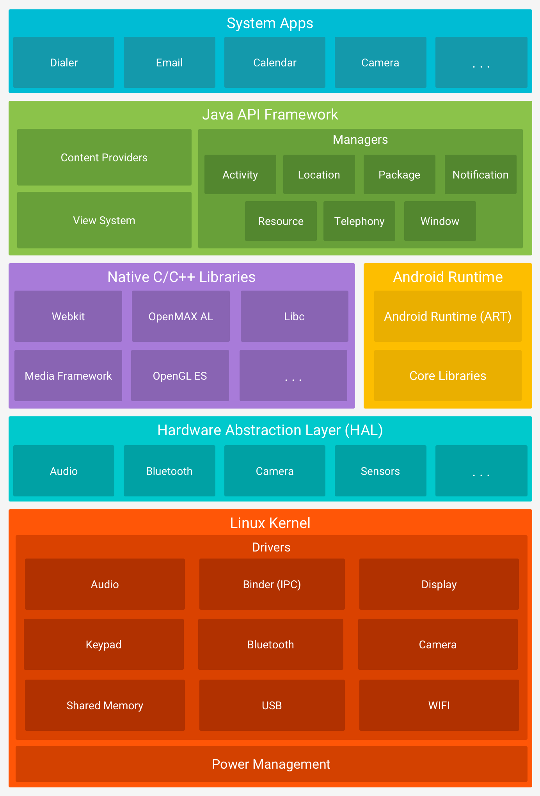
Android Architecture
Application Layer : System Apps and 3rd Party Apps
Android Framework Layer : Framework resources
Android Libs and ART Layer : Android Code compilation and also provides environment for applications developing in C or C++
HAL Layer : Hardware devices interaction start
Linux Kernel Layer : Base layer where Android Bootup will start
Notes:
Go to Link -> https://source.android.com/docs/core/architecture
Application layer -> this is for Android app Android Framework -> this is also called JAVA layer, it provides all the API’s to build the App Activity manger -> manages all the lifecycle of each application
Location manager – this provide the geographic location and positioning functions. Package manager -> manage all application installed in the android system
Notification manager -> allow application to display all the notification in the status bar
Resource managers -> manages all the resources such as layout, color etc….
Windows manager -> manages the all the open windows
View system -> it builds the essential view components of the application
Contet providers -> allow data to share between different applications
Android Runtime Framework ->Android runtime is DVM (Dalvik virtual machine) for Allowing multiple instances of virtual machine to run in limited memory
After Android 5.0 DVK is replaced by ART
Core library -> provides most of java language core library fucntions so that developers can use the java language.

Slide 31
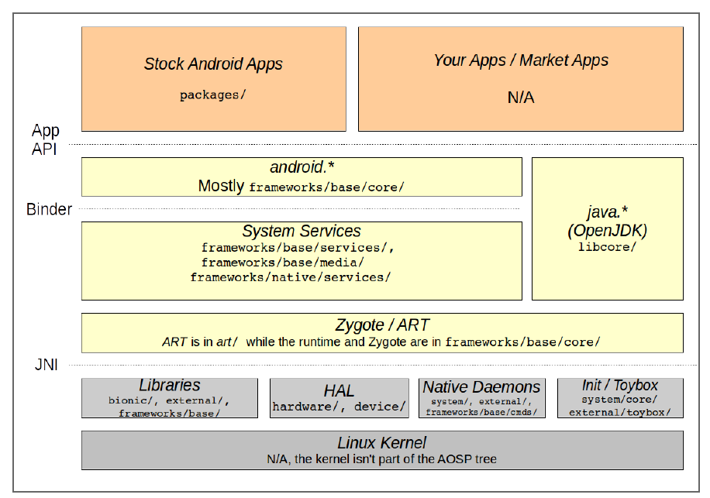
Android Directory Structure
Notes:
go to -> https://cs.android.com/android/platform/superproject/main explain about all the files and folder of android explain about repo, explain about git, explain about gerrit and explain about manifest files.
Show .repo folder and explain manifest files….

Slide 32
Oracle Vs Google
Oracle v. Google
Filed August 2010
Patent infringement:
6,125,447; 6,192,476; 5,966,702; 7,426,720; RE38,104; 6,910,205; and 6,061,520
Copyright infringement:
Android does not use any Oracle Java libraries or JVM in the final product.
Android relies on Apache Harmony and Dalvik instead.
In October 2010, IBM left Apache Harmony to
join work on Oracle's OpenJDK, leaving the project practically orphaned.
...
In Spring of 2012 Oracle lost both on Copyright and Patent fronts
Oracle appealed
Notes:
Go to Link -> https://source.android.com/docs/core/architecture
Application layer -> this is for Android app Android Framework -> this is also called JAVA layer, it provides all the API’s to build the App Activity manger -> manages all the lifecycle of each application
Location manager – this provide the geographic location and positioning functions. Package manager -> manage all application installed in the android system
Notification manager -> allow application to display all the notification in the status bar
Resource managers -> manages all the resources such as layout, color etc….
Windows manager -> manages the all the open windows
View system -> it builds the essential view components of the application
Contet providers -> allow data to share between different applications
Android Runtime Framework ->Android runtime is DVM (Dalvik virtual machine) for Allowing multiple instances of virtual machine to run in limited memory
After Android 5.0 DVK is replaced by ART
Core library -> provides most of java language core library fucntions so that developers can use the java language.

Slide 33
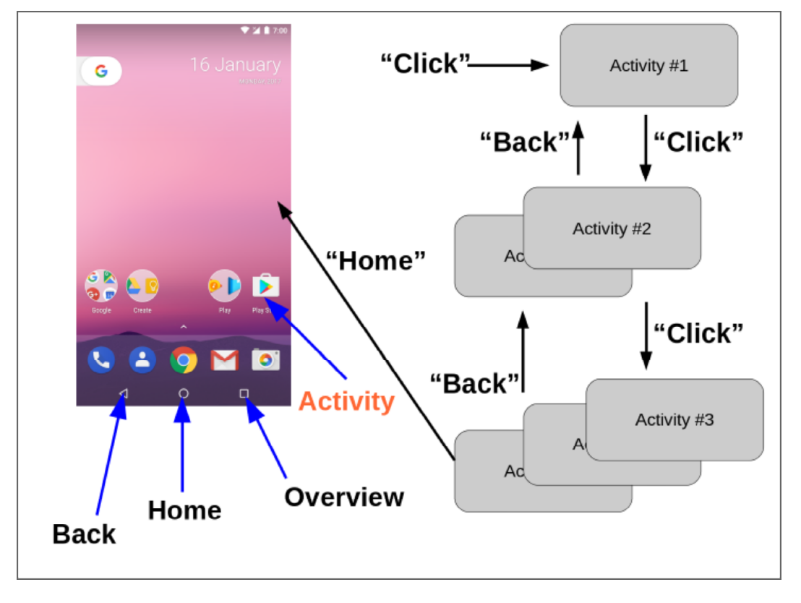

Slide 34

Android Architecture
Android Applications
Role : The top layer where developers create and manage Android applications using the Android Framework APIs.
Components :
Activities: Represents a single screen with a user interface.
Services: Handles background tasks and operations.
Broadcast Receivers: Responds to broadcast messages from the system or other applications.
Content Providers: Manages and provides access to application data
.

Slide 35
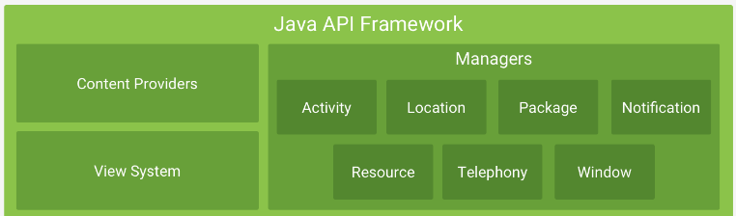
Android Architecture
Android Framework
Role : Provides high-level APIs for building Android applications. It offers the essential tools and services needed for app development
Components :
Activity Manager: Manages the lifecycle of activities and tasks, handles task switching and process management.
Window Manager: Manages the display and layout of windows and views on the screen.
Package Manager: Handles application installation, uninstallation, and management of app permissions.
Resource Manager: Manages app resources like strings, layouts, and drawables.
Notification Manager: Handles notifications and alerts to the user.
Content Providers: Facilitates data sharing between applications.
Location Manager: Provides location-based services and access to GPS and network-based location data.

Slide 36
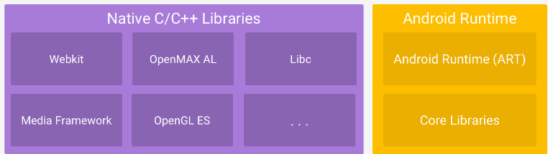
Android Architecture
Android Run Time (ART)
Role : Executes Android applications. ART has replaced Dalvik VM as the runtime environment for running apps.
Components :
ART (Android Runtime): Includes AOT (Ahead-Of-Time) and JIT (Just-In-Time) compilation to
optimize app performance.
Garbage Collector: Manages memory allocation and deallocation for efficient memory usage.

Slide 37
Android Architecture
Native Libraries C/C++
Role : Provide essential functionalities and services needed by Android applications and system components
Components :
Core Libraries: Include Java-based libraries for common functionalities (e.g., collections, I/O, networking).
Media Framework: Handles audio, video, and graphics processing (e.g., ExoPlayer, OpenGL ES).
SQLite: Provides a lightweight database for local data storage.
WebKit: Used for rendering web content in WebView

Slide 38
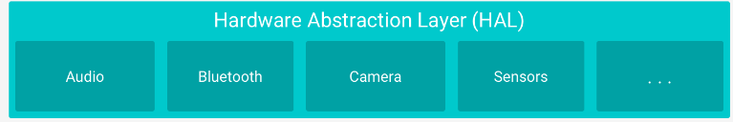
Android Architecture
HAL
Role:
HAL provides a standardized interface
between the hardware and the Android framework, allowing Android to communicate with
different hardware components .
Components :
HAL Interfaces: Define methods for interacting with hardware components such as sensors, cameras, and GPS
Implementation: Each hardware vendor provides specific implementations for these interfaces, ensuring compatibility with the Android framework.

Slide 39
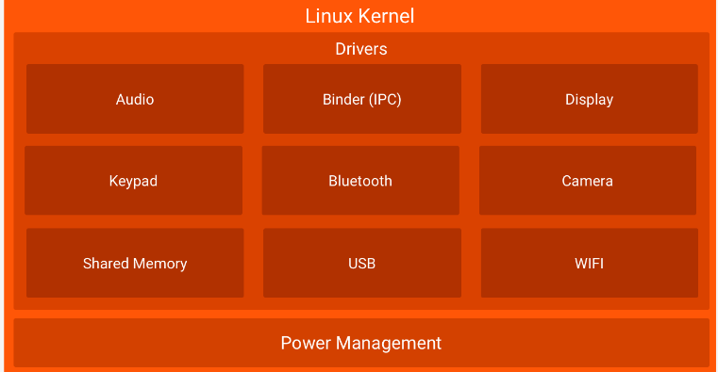
Android Architecture
Linux Kernel
Role:
The Linux kernel is the core of the Android
operating system .It handles low-level operations and system services.
Components :
Kernel: Manages hardware abstraction,
process management, memory management
and system calls.
Drivers: Provides drivers for various hardware components like the display, camera, and network interfaces.
Hardware Abstraction: Manages communication between hardware and the higher-level Android framework

Slide 40
Languages used for Development
Java /Kotlin
Java /Kotlin for new Applications
C/C++
C/C++
Native C

Slide 41



Android Studio, SDK & Emulator
Android Studio is the IDE where developers write, test, and debug their applications. It integrates various tools and utilities needed for Android development.
Android SDK provides the core tools and libraries required for building Android apps. It includes essential components like platform tools, build tools, and libraries that Android Studio uses to compile and run applications.
Android Emulator is a powerful tool for Android developers, providing a versatile environment for testing and debugging applications across various devices and Android versions

Slide 42
Android Studio, SDK & Emulator
Android Studio
Android Studio is official IDE used for Android Application Development
Android Studio is Developed and Supported by Google & it is Open Source
It integrates code editing, debugging, performance monitoring, and testing tools into a single environment, providing developers with everything needed to create high-quality Android applications
- How to Download Android Studio? Link
- How to Install the Android Studio ? Link

Slide 43
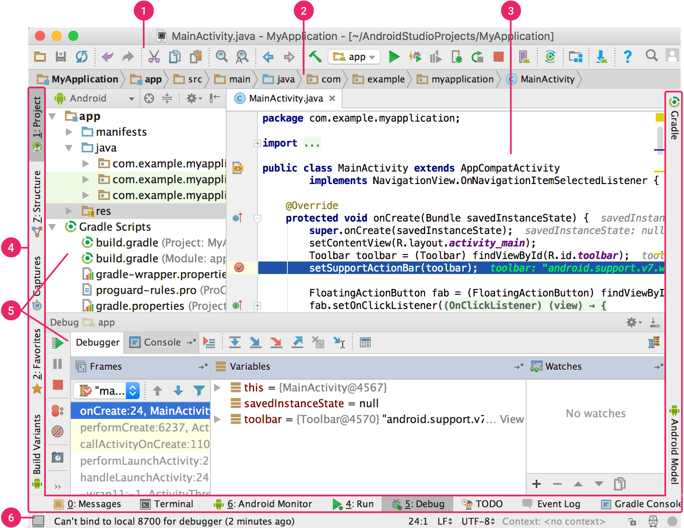
Android Studio, SDK & Emulator
Android Studio Overview
1 – Toolbar
2 - Navigation Bar
3 – Editor window
4 – Toolbar Winodw
5- Tool Windows
6 – Status Bar

Slide 44
Android Studio, SDK & Emulator
Android SDK
The Android SDK is a vital resource for Android developers
Android SDK Providing all the necessary tools, libraries, and documentation to build, test, and debug Android applications
Android includes components like SDK tools, platform tools, libraries, documentation, and the Android Emulator, all of which are essential for developing high-quality Android apps.
We can Download SDK 2 ways, Using Android Studio & Manual Download from The Android Developer Website link below.
- How to Download Android SDK? Link

Slide 45
Android Studio, SDK & Emulator
Android Emulator
Emulator is like Virtual Device in Android Studio
We can’t have all the devices(Different Versions,Different Sizes) we used for development means Physical Devices
With the Android Emulators we can Navigate, Debug , Build & Run our applications
We can create emulators for Various Android Devices like Mobile, Tablet , Watch and Automotive

Slide 46
Q & A

Slide 47
Thank you

Slide 48
Android Automotive

Slide 49
AAOSP Agenda
Introduction to Android Automotive
Overview of Android Automotive
History, evolution, and key features.
Android Automotive vs. Android Auto.
Overview of Android Automotive OS vs. Android Auto.
Core differences, use cases, and market adoption.
Architecture of Android Automotive OS
Core Components and Layers
Practical Session =>
Setting Up Android Automotive Environment on Laptop
Configuring and exploring the Android Automotive environment.
Downloading and flashing Android Automotive for Telechips HW.
Set up the Android Automotive environment on Telechips and explore its features

Slide 50
Why Use Android in Cars?

Slide 51
Automotive Industry Expectations for In-Car OS:
Intuitive Touch Interface
Vast App & Developer Ecosystem:
Always Connected
Notes:
Intuitive Touch Interface:
Supports swipe, pinch-zoom, and multi-touch gestures.
Vast App & Developer Ecosystem:
Access to millions of apps (navigation, media, communication, etc.).
Strong developer community ensuring constant updates and innovation.
Always Connected:
Seamless integration with smartphones, cloud services, and IoT devices.
Real-time updates for navigation, weather, traffic, and more.

Slide 52
User Expectations for In-Car OS:
Real-Time Updated Data
Voice Assistants
Customizable Interfaces
Notes:
Real-Time Updated Data:
Advanced navigation with live traffic, weather, and POI updates.
Voice Assistants:
Hands-free control through Google Assistant or custom voice solutions.
Enhanced safety and convenience.
Customizable Interfaces:
OEMs can tailor UI/UX to brand identity.
Support for multi-display setups (cluster, IVI, HUD).

Slide 53
Why Android selected for Automotive ?
Open-Source Flexibility:
Customizable Platform
Rapid Innovation
Cost-Effective Development
Strong Ecosystem & Future-Proofing:
Google Automotive Services (GAS)
AI & ML Integration
Notes:
1. Open-Source Flexibility:
Customizable Platform:
OEMs and Tier-1s can adapt Android to fit specific needs.
Rapid Innovation:
Regular updates and security patches from Google and the community.
Cost-Effective Development:
No licensing fees, reducing time-to-market and development costs.
2. Strong Ecosystem & Future-Proofing:
Google Automotive Services (GAS):
Access to Google Maps, Play Store, Assistant, etc.
AI & ML Integration:
Supports advanced driver assistance systems (ADAS) and predictive features.

Slide 54
Challenges of Using Android in Cars ?

Slide 55
Challenges:
Existing Car Environment
Security Concerns
Long Lifecycle Challenges
Efficient Resource Management and Power Consumption
Rear-View Camera & Real-Time Requirements
Google’s Influence
Device Longevity vs. Software Evolution
Regulatory & Compliance Hurdles
Notes:
1. Integration Complexity:
Existing Car Environment:
Adapting Android to work seamlessly with legacy vehicle systems (CAN, LIN, MOST, etc.).
Managing diverse sensor and actuator inputs (e.g., speed, climate control).
2. Security Concerns:
Cybersecurity Risks:
Android’s open nature increases exposure to potential vulnerabilities.
Need for robust sandboxing, secure boot, and over-the-air (OTA) updates.
3. Upgradability & Maintenance:
Long Lifecycle Challenges:
Vehicles have longer lifespans than consumer devices (~10-15 years).
Ensuring regular software updates and security patches throughout the vehicle's life.
1. Power Consumption:
Efficient Resource Management:
Android, originally designed for mobile devices, must be optimized for low-power automotive scenarios (e.g., quick boot, low idle power).
2. Rear-View Camera & Real-Time Requirements:
Latency & Performance:
Real-time camera feed requires low-latency processing, which Android isn’t natively optimized for.
Critical safety features demand deterministic behavior.
3. Storage & Hardware Reliability:
Storage Wear-Leveling:
High write cycles in automotive applications necessitate wear-leveling strategies for eMMC/SSD storage to prevent early failure.
1. Ecosystem Control & Vendor Lock-In:
Google’s Influence:
Android is open-source, but key services (e.g., Google Maps, Play Store) are controlled by Google, leading to potential vendor lock-in for GAS (Google Automotive Services).
2. Device Longevity vs. Software Evolution:
Designed for Disposable Devices:
Android’s rapid update cycle and focus on consumer devices can clash with the long-term support needs of automotive platforms.
Continuous integration and testing required to keep up with new Android versions.
3. Regulatory & Compliance Hurdles:
Meeting Automotive Standards:
Adapting Android to comply with safety-critical automotive standards (e.g., ISO 26262, ASPICE).

Slide 56
AAOSP Boot time
Typically > 20 seconds
But there are regulatory requirements for some critical services to be available within a few seconds, e.g. exterior camera
Notes:
Solution => Optimise Bootime ->
https://source.android.com/docs/core/perf/boot-times
Exterior cameras are handled by the Extended View System, EVS
EVS is started early, before the main operating system is running

Slide 57
AOSP Software update cycle
AOSP has major release every 12 months, security updates every month, each major release supported for 3 years
SoC vendors support kernel and drivers for typically 3 years
Notes:
AOSP Release Cycle:
Major Releases: Every 12 months (e.g., Android 12 → Android 13 → Android 14).
Security Updates: Monthly patches for active releases.
Support Timeline: Each major Android release is officially supported by Google for 3 years.
SoC Vendor Support:
SoC (System on Chip) vendors (e.g., Qualcomm, NVIDIA) typically provide kernel and driver updates for about 3 years from launch.
Automotive Lifespan Conflict:
Vehicles’ Lifespan: Cars are expected to operate for 10-15 years, leading to a gap where the software becomes unsupported long before the vehicle reaches its end-of-life. Solution => Planned EOL (End of Life) Cycle:
Three Major Releases + 3 Years Support:
For example, if a vehicle launches with Android 12, it may receive updates up to Android 14.
Android 14 would then be supported with security patches for 3 more years.
Total Supported Lifespan:
3 Years (First Release) + 1 Year (Next Release) + 1 Year (Next Release) + 3 Years (Final Release Security Patches)
Results in approximately 6 years of official support before the system reaches EOL.
After 6 years ➔
Post-Google Support:
Once Google and SoC vendors cease updates, OEMs (Original Equipment Manufacturers) or Tier 1 suppliers take over self-support.
Key Self-Support Activities:
Security Patching: Backporting critical security fixes to the existing platform.
Bug Fixes: Maintaining core system stability and addressing functional bugs.
Hardware Maintenance: Supporting and updating drivers for aging hardware.
Regulatory Compliance: Ensuring the system adheres to evolving safety and privacy standards.
While 6 years doesn’t cover the entire vehicle lifespan, it significantly bridges the gap, and combined with self-support, ensures that vehicles can safely and securely operate for their intended lifespan.

Slide 58
AAOSP Hardware Requirements
Android requires fast CPU, lots of RAM, lots of flash storage
Requirements increase every year with each new release
Notes:
Solution => Mitigation
EOL hardware when it becomes unable to run latest release and support period has elapsed, or ...
... update hardware every 2 to 5 years

Slide 59
AAOSP Flash Memory lifespan
Lifespan of vehicle > 10 years
eMMC Flash Memory, commonly used in automotive systems may wear out in < 5 years
Why ? Becoz Flash memory has a limited number of erase/write cycles (typically 3,000 cycles for standard eMMC).
For example, writing 32GB per day on 16GB eMMC with 3k erase/write cycles
Scenario is worse because of flash memory write amplification, caused by garbage collection and wear levelling
Writes to flash = writes from host * amplification factor
Notes:
Solution => 1. Reduce flash writes,
https://source.android.com/devices/tech/perf/flash-wear
2. Add CarStorageMonitoringService
CarStorageMonitoringService is part of Car Service
Tracks flash reads and writes per UID (i.e. system services and each app)
Provides WearHistory and estimated lifetime remaining
CarStorageMonitoringService PATH -
https://cs.android.com/android/platform/superproject/main/+/main:/packages/services/Car/service/src/com/android/car/CarStorageMonitoringService.java Garbage Collection (GC) ♻️
Garbage Collection is a process used in flash memory (like eMMC, UFS, or SSD) to manage data and free up space for new writes.
Why is it Needed?
Flash memory can't overwrite data directly. It must erase a block before writing new data.
Data blocks often contain a mix of valid (active) and invalid (stale/deleted) data.
How Does It Work?
Identify Blocks: GC looks for blocks that have invalid or stale data.
Copy Valid Data: It moves valid data from partially filled blocks to new or clean blocks.
Erase Blocks: Once the valid data is moved, the old block is erased and marked as free space.
Write New Data: The now-empty block is ready to accept new data.

Slide 60
Automotive Android

Slide 61
Android Auto
NOTE => This is NOT Android Automotive
Android Auto is:
A proprietary SDK written mostly in C++ with support for Linux, Android, and QNX
A protocol for connecting an Android phone to a car head unit
Projects apps from your phone to the car’s infotainment system.
Requires a connected smartphone to function.
It is based on Android Open Accessory Protocol over USB and (recently) WiFi also used
Uses Protocol Buffers to divide data into channels:
output from phone: display data (H.264), audio (PCM)
input to phone: car sensors and inputs
Notes:
Android Auto => https://www.android.com/auto/
There is an open-source implementation of an Android Auto head unit for RPi 3B called OpenAuto:
https://opensource.com/article/18/3/openauto-emulator-Raspberry-Pi
Title: Limitations of Android Auto Key Points:
Smartphone Dependency:
Requires a compatible Android smartphone to function.
No smartphone = no Android Auto.
Limited Functionality:
Only supports a subset of apps (e.g., navigation, media, messaging).
Cannot run full Android apps or services.
Connectivity Issues:
Relies on a stable USB or Bluetooth connection.
Connection drops or compatibility issues can disrupt the experience.
Hardware Limitations:
Performance depends on the smartphone’s capabilities.
Older or low-end phones may struggle with performance.
No Standalone Features:
Cannot operate independently of a smartphone.
Lacks deep integration with the car’s native systems (e.g., climate control, diagnostics).

Slide 62
Android Automotive OS (AAOSP)
Android Automotive OS is part of AOSP
But, it is not a production-ready solution
You need:
integration with the vehicle: CAN bus, sensors, audio, power, ...
apps that integrate with the vehicle, e.g. to turn lights on and off
home screen (the default is only a demo)
app store, navigation and voice recognition
back-end services for all of the above
Google has a solution ...
Notes:
Android Automotive =>
https://source.android.com/docs/automotive/

Slide 63
Google Automotive Services (GAS)
Non-free services on top of AOSP
similar to Google Mobile Services (GMS) in the smartphone world
Includes
Play Store
Google Assistant
Google Maps
Per-unit license
Must pass tests: CTS, VTS, ATS, ..
Must install Google apps
Notes:
https://source.android.com/docs/automotive/start/what_automotive
https://developers.google.com/cars

Slide 64
No GAS
Without GAS, you need to find alternative apps and services
typically, a combination of in-house and third party
some tier one companies have SDKs that you can use

Slide 65
Android Auto vs Automotive AOSP

Slide 66
2014: Android Auto
Screen cast / projection from smart phone to head unit display
An SDK integrated into the head unit (which is usually not running Android)
Mirrors apps like Google Maps, Music, and Messages from your phone to your car’s display.
Apple CarPlay is a similar concept
2017: Android Automotive OS
A full-fledged Android In-Vehicle Infotainment (IVI) system.
Runs directly on the car's head unit without relying on a smartphone.
Android has been used in IVI for a long time, e.g. Honda (based on M/6) and Hyundai (based on JB/4.2).
Notes:
Android Auto => https://www.android.com/auto/
Android Automotive =>
https://source.android.com/docs/automotive/
https://source.android.com/docs/automotive/start/what_automotive
https://developers.google.com/cars

Slide 67
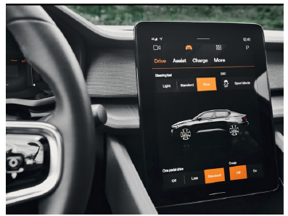
The Polestar 2 was the first vehicle to run Android
Automotive OS
Notes:
https://arstechnica.com/cars/2021/05/android-automotive-os-review-under-the-hood-with-googles-car-os/

Slide 68
Automotive AOSP Architecture

Slide 69
Android AOSP Architecture

Slide 70
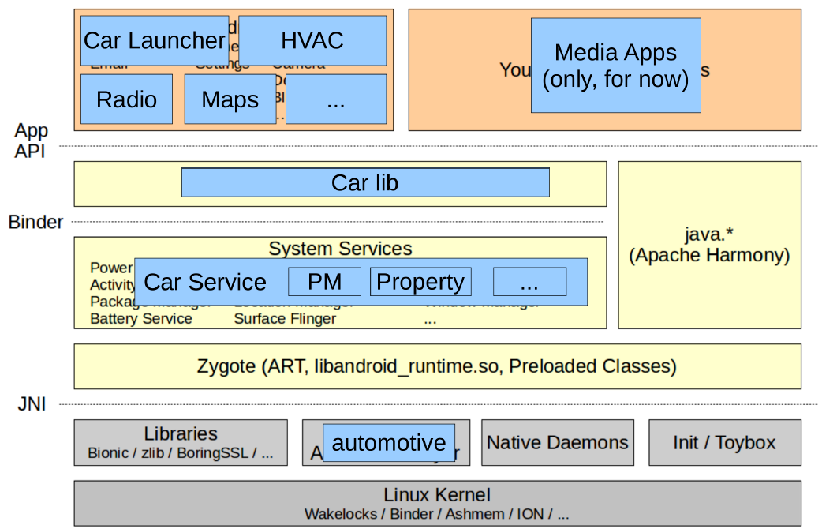
Automotive AOSP (AAOSP) Architecture
Notes:
https://source.android.com/docs/automotive
https://developers.google.com/cars/design/automotive-os

Slide 71
AOSP vs AAOSP Architecture
Notes:
https://source.android.com/docs/automotive
https://developers.google.com/cars/design/automotive-os

Slide 72
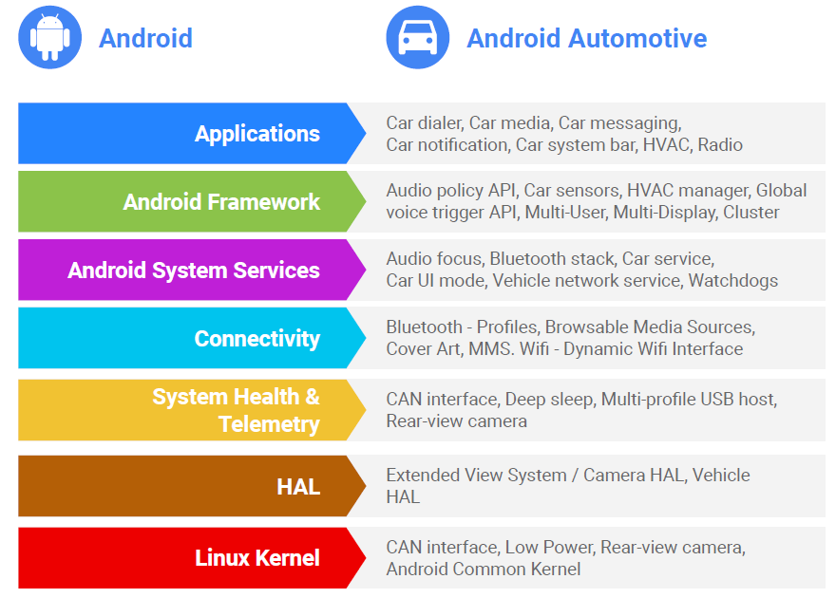
AOSP vs AAOSP
The Automotive AOSP (AAOSP)
optimized and extended Android Operating System (AOSP) for automotive
infotainment systems
Notes:
https://source.android.com/docs/automotive
https://developers.google.com/cars/design/automotive-os

Slide 73
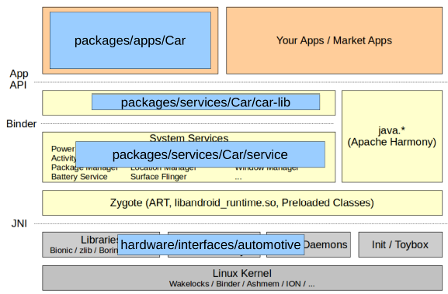
AAOSP Directory Structure
Notes:
https://source.android.com/docs/automotive
https://developers.google.com/cars/design/automotive-os

Slide 74
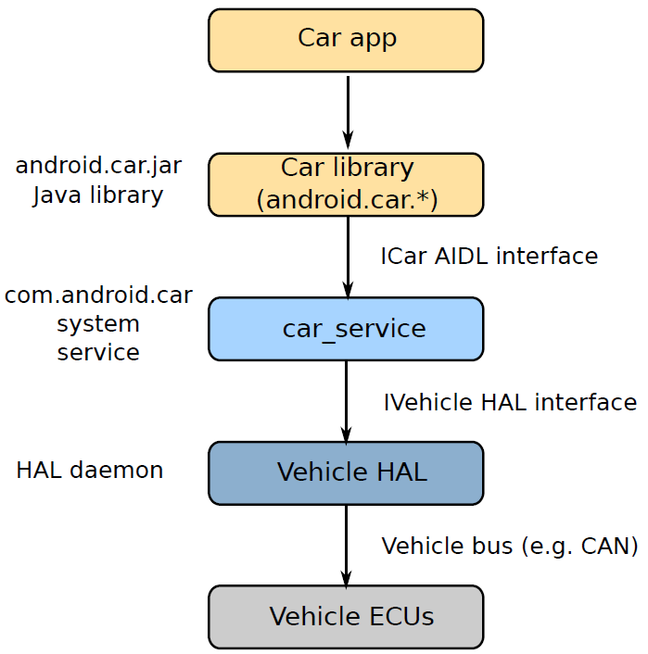
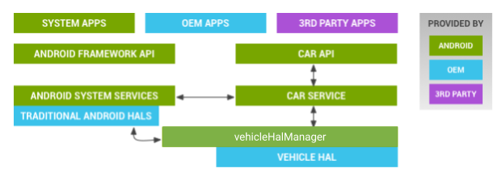
AAOSP Architecture

Slide 75
Car apps
AOSP contains a basic set of demo car apps
These are all system apps, intended to be shipped with the head unit
OEMs are expected to write their own versions using these as a guide
Notes:
Apps in packages/apps/Car

Slide 76
Car Manager
Interface library for Car Service
Contains the android.car packages required to write car apps, including android.car.Car
Notes:
Source code packages/services/Car/car-lib

Slide 77
Car Services
System service acting as a container for many (20 - 30) app level services
Service named car_service
Mostly a wrapper for VHAL properties
Notes:
Source code packages/services/Car/service

Slide 78
Example Car Services
CarUserService
SystemActivityMonitoringService
CarPowerManagementService
CarPropertyService
CarDrivingStateService
CarUXRestrictionsService
CarPackageManagerService
CarInputService
GarageModeService
CarUserNoticeService
AppFocusService
CarAudioService
CarNightService
InstrumentClusterService
CarLocationService
CarBugreportManagerService
Notes:
Source code packages/services/Car/service

Slide 79
Vehical HAL
The Vehicle HAL (VHAL) mediates between Android and the vehicle
It Allows apps and the Android framework to
monitor variables, e.g. speed
control variables, e.g. side window position
Vehicle variables are represented as vehicle properties
Properties have names such as PERF_VEHICLE_SPEED and WINDOW_POS
Notes:
Source code hardware/interfaces/automotive/vehicle/2.0

Slide 80
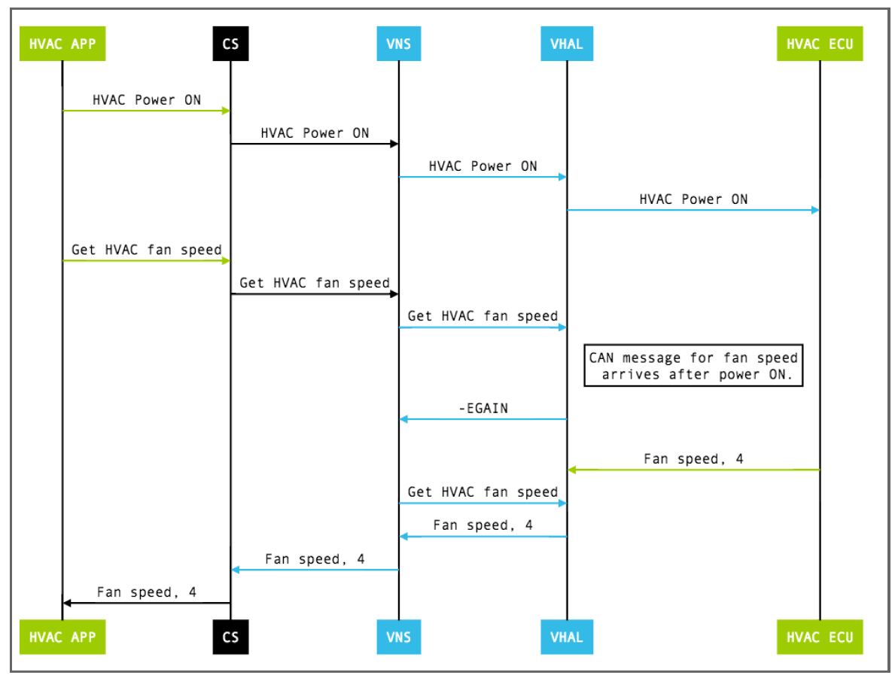
Get calls
Sequence Diagram how an HVAC (Heating, Ventilation, and Air Conditioning) fan speed "get" request flows through the automotive Android (AOSP) stack.
Notes:
https://source.android.com/docs/automotive/vhal
https://source.android.com/docs/automotive/vhal/previous/properties
Components in the Diagram
HVAC APP: User-facing application (UI or app) requesting the fan speed.
CS (Car Service): Android Car Service layer, mediating system services.
VNS (Vehicle Network Service): Middleware translating Android vehicle property requests.
VHAL (Vehicle HAL): Vehicle Hardware Abstraction Layer, the bridge between Android and real car hardware.
HVAC ECU: Actual vehicle electronic control unit responsible for HVAC.
Step-by-Step Explanation of the Flow
Power ON Sequence:
HVAC Power ON command is initiated from the HVAC APP and passed down the stack (CS → VNS → VHAL → HVAC ECU).
Get HVAC Fan Speed Request:
After powering on, the app requests the HVAC fan speed.
This request goes from HVAC APP → CS → VNS → VHAL.
CAN Message Delay:
The VHAL asks the HVAC ECU for fan speed, but the ECU's response ("CAN message for fan speed arrives after power ON") is not immediate.
At this moment, VHAL cannot provide the value, so it returns -EAGAIN, indicating the data is temporarily unavailable (must try again later).
Fan Speed Data Becomes Available:
Eventually, the fan speed (Fan speed, 4) is received from the HVAC ECU (via a CAN bus message, which is delayed after power on).
VHAL then responds back to VNS with the actual fan speed.
Propagation to App:
The fan speed value is passed up the stack (VNS → CS → HVAC APP).
The user/app now receives the actual value.

Slide 81
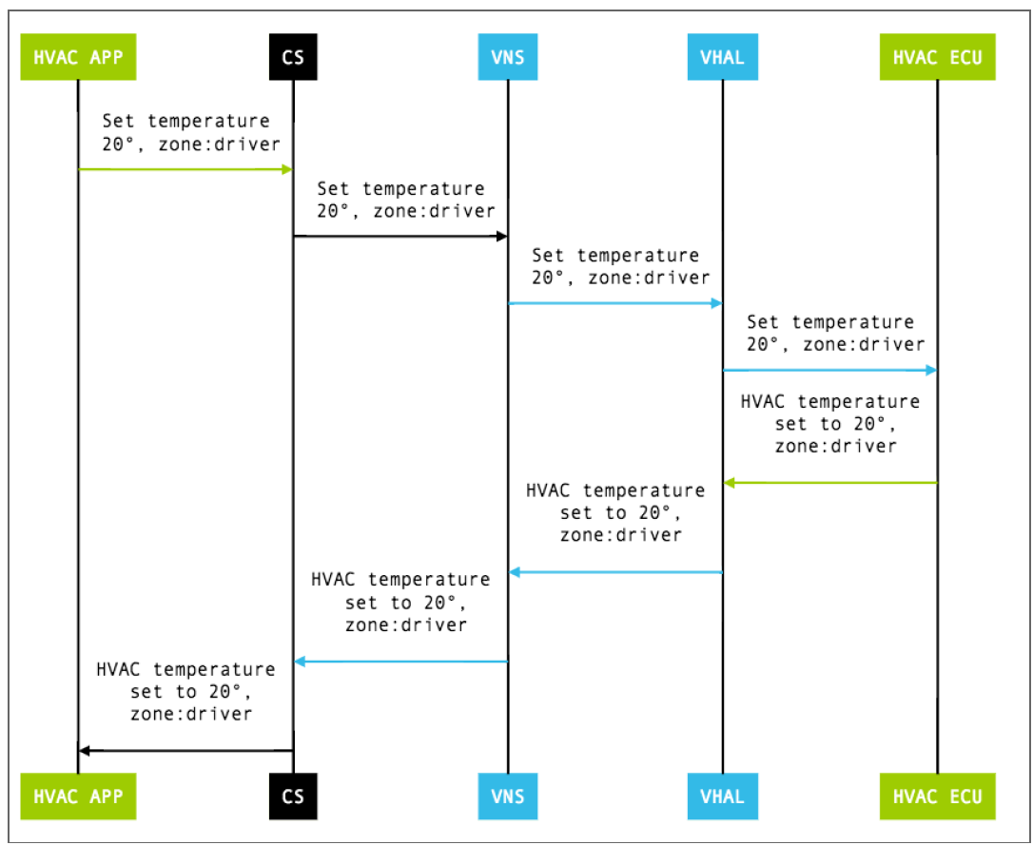
Set calls
Sequence diagram showing the "set" operation for HVAC temperature
Notes:
https://source.android.com/docs/automotive/vhal
https://source.android.com/docs/automotive/vhal/previous/properties
Components in the Diagram
HVAC APP: The application (user interface) initiating the temperature set command.
CS (Car Service): Android Car Service managing car-related system requests.
VNS (Vehicle Network Service): Middleware that translates Android service commands to vehicle-specific messages.
VHAL (Vehicle HAL): The abstraction layer between Android framework and vehicle hardware.
HVAC ECU: The electronic control unit controlling HVAC hardware.
Step-by-Step Explanation
Set Temperature Request from App:
Set temperature 20°, zone: driver: The HVAC app issues a command to set the temperature inside the vehicle.
Command Propagation:
This command flows down through the layers in order: HVAC APP → CS → VNS → VHAL → HVAC ECU.
Each layer simply forwards the command to the next layer.
Acknowledgment Flow Back:
Once the HVAC ECU processes the temperature command, it confirms the setting.
The confirmation message flows upward from HVAC ECU → VHAL → VNS → CS → HVAC APP.
The app receives confirmation that the HVAC temperature is now set to 20° in the driver zone.

Slide 82
Automotive AOSP A14 Build Steps

Slide 83
The best operating systems for building AOSP T/13 or U/14 are Ubuntu 20.04 Step 1 :
You need to install some extra packages for the AOSP build, as described here…
https://source.android.com/source/initializing.html Step 2:
$ sudo apt install flex bison gcc-multilib g++-multilib git gperf \
libxml2-utils make zlib1g-dev zip curl \
patch vim lzop tree python python-mako ccache libncurses5-dev libssl-dev \
graphviz qemu-kvm eog

Slide 84
Step 3:
Set python3 as default. For Ubuntu 20.04 –
$ sudo apt install python-is-python3
Step 4:
Install repo
$ curl https://storage.googleapis.com/git-repo-downloads/repo > $HOME/bin/repo
$ chmod a+x $HOME/bin/repo
$ export PATH=$(pwd):${PATH}
Step 5:
Install AOSP
$ mkdir aosp
$ cd aosp
$ repo init -u https://android.googlesource.com/platform/manifest -b android-14.0.0_r21
$ repo sync -c

Slide 85
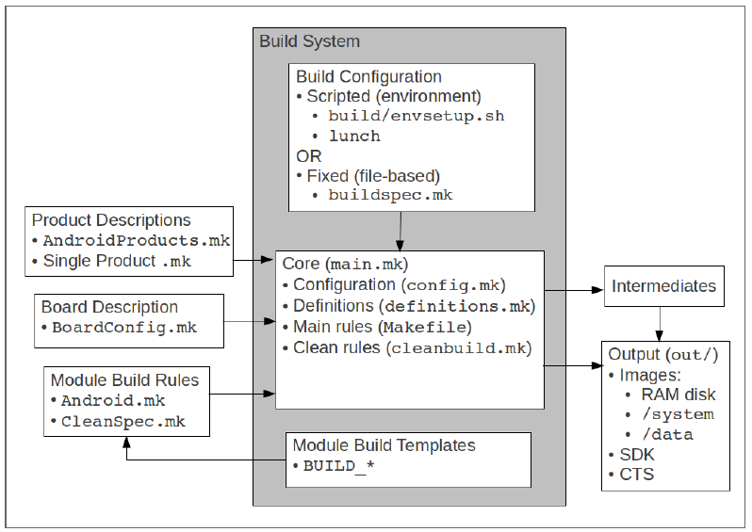
Android Build System Architecture diagram
Notes:
This diagram shows how Android’s build system works with Makefiles (Android.mk, BoardConfig.mk, etc.) to produce the final images under out/.
🔹 Components and Flow
1️⃣ Product Descriptions
Files:
device/<vendor>/<product>/AndroidProducts.mk
device/<vendor>/<product>/<product_name>.mk
Define the product identity:
Device name and vendor
Which apps, libraries, and features to include
Build variants (user, userdebug, eng)
Inherit common configurations (e.g., aosp_base.mk)
🧠 Purpose: It tells the build system “what we are building.”
2️⃣ Board Description
File:
device/<vendor>/<board>/BoardConfig.mk
Defines hardware-specific settings:
CPU architecture (TARGET_ARCH)
Bootloader name, kernel path
Partition sizes (system, boot, userdata)
Display, Wi-Fi, Bluetooth config
🧠 Purpose: Informs build system “how to build for this hardware.”
3️⃣ Module Build Rules
Files:
Android.mk
CleanSpec.mk
Define how each module (app, library, HAL, binary) is built:
Compilation sources
Dependencies
Install paths (/system/bin, /vendor/lib)
Module type (BUILD_EXECUTABLE, BUILD_SHARED_LIBRARY, etc.)
🧠 Purpose: Controls compilation of each software component.
4️⃣ Build System Core
Located in:
build/core/
Includes:
config.mk – global variables, environment setup
definitions.mk – macros and generic rules
main.mk – main dependency logic (what to build)
cleanbuild.mk – rules for cleaning intermediates
🧠 Purpose: Central engine that coordinates all make rules.
5️⃣ Build Configuration
Setup scripts or environment files:
build/envsetup.sh
lunch <product>-<variant>
buildspec.mk
These define environment variables:
TARGET_PRODUCT
TARGET_BUILD_VARIANT
TARGET_BUILD_TYPE and prepare your shell environment for building.
🧠 Purpose: Establishes global environment and selects which product/device to build.
6️⃣ Module Build Templates
File: BUILD_*.mk
Generic templates for each module type (app, binary, library).
🧠 Purpose: Avoid rewriting rules for each module; reuse common templates.
7️⃣ Intermediates and Output
After the build (make, m, or mmm):
out/
├── target/product/<device>/
│ ├── system.img
│ ├── boot.img
│ ├── userdata.img
│ ├── ramdisk.img
│ └── recovery.img
└── host/
🧠 Purpose: Final artifacts ready for flashing or testing (SDK, CTS, OTA).

Slide 86
Lunch
The lunch command selects the device to build
Sets up the shell environment, including:
$ANDROID_BUILD_TOP -> Top of the AOSP source tree
$ANDROID_PRODUCT_OUT -> Staging area for product files
$OUT -> Same as $ANDROID_PRODUCT_OUT
$PATH -> Includes build tools in
aosp/out/host/linux-x86/bin
and other places

Slide 87
Step 5:
$ cd $HOME/aosp
$ source build/envsetup.sh
$ lunch lunch aosp_cf_x86_64_phone-eng
$ make –j$(nproc) Or make –j32
NOTE - The lunch menu is assembled by reading device/*/*/AndroidProducts.mk
NOTE - build type is one of =>
user -> limited access; suited for production
userdebug -> like "user" but with root access, suitable for debugging
eng -> development configuration with additional debugging tools
Notes:
Show => Android A14 device folder and all the files…
In parallel also show => Telechip
envsetup.sh contains several useful commands, including:
hmm Help text
croot Change directory to the top of the tree
godir Go to the directory containing a file
cgrep Grep all local C/C++ files
jgrep Grep all local Java files
resgrep Grep all local xml files
allmod List all modules
gomod Go to the directory containing a module
pathmod Get the directory containing a module
refreshmod Refresh list of modules
lunch Select the build target (next slide)
printconfig Information about selected target

Slide 88
After the build
All intermediate and binary files are put in directory out/
Host executables are put in out/host/linux-x86/bin/
Utilities used during the build
Debug and dev tools such as adb and fastboot
Target files are put in out/target/product/[product name]
This path is stored in $ANDROID_PRODUCT_OUT and also in $OUT

Slide 89
Our Customized Device configuration
Step 6:
Get XRDA3 (AOSP) and XRDA3CAR (AAOSP) device configuration and Lunch option –
$ cd $HOME/aosp
$ git clone https://github.com/BuildandShip-stack/xrda3-local-manifest/tree/android14 .repo/local_manifests \
-b android14
$ repo sync –c
Step 7:
$ cd $HOME/aosp
$ source build/envsetup.sh
$ lunch
Select xrda3car-userdebug from the lunch menu
$ make -j32
Notes:
Show => Android A14 device folder and all the files…
In parallel also show => Telechip
Highlight car lunch options
link 1 for device folder ,lunch option –
https://github.com/BuildandShip-stack/training_XRDA3/tree/android14
Link 2 for manifest file –
https://github.com/BuildandShip-stack/xrda3-local-manifest/tree/android14

Slide 90
Creating a new device
Device configurations can be in device/ or vendor/ directories
There is a two-level hierarchy
organization/product
The examples that follow use xrda3
The two key files are AndroidProducts.mk and BoardConfig.mk
The next few slides describe these essential files...

Slide 91
AndroidProducts.mk
This is the top-level makefile for a product
PRODUCT_MAKEFILES lists one or more makefiles
(Since Q/10) COMMON_LUNCH_CHOICES contains items to add to lunch menu
A simple example:
PRODUCT_MAKEFILES := $(LOCAL_DIR)/xrda3.mk
COMMON_LUNCH_CHOICES := \
xrda3-eng
Search path for AndroidProducts.mk is
device/*
vendor/*
$LOCAL_DIR is the path to the directory containing the AndroidProducts.mk file

Slide 92
Product makefiles (e.g. xrda3.mk)
One per product
Variable names mostly begin with PRODUCT_
Must
inherit detailed product definition, normally a generic product followed by local
product
set PRODUCT_NAME to base name of the product makefile
set PRODUCT_DEVICE to the directory that contains the BoardConfig.mk file
Simple example -> File name xrda3.mk
$(call inherit-product, $(LOCAL_PATH)/device.mk)
PRODUCT_NAME := xrda3
PRODUCT_DEVICE := xrda3
PRODUCT_BRAND := XRDA3_Cybernetics
PRODUCT_MODEL := XRDA3 Phone
Meaning of variables
Tag System property Usage
PRODUCT_NAME ro.product.name Copied to $TARGET_PRODUCT
PRODUCT_DEVICE ro.product.device Location of BoardConfig.mk; directory in $OUT
PRODUCT_MODEL ro.product.model T ext displayed in About - Model number
PRODUCT_BRAND ro.product.brand Build fingerprint (mustn’t contain spaces

Slide 93
Pre-defined products
Phone: $AOSP/build/target/product/aosp_base_telephony.mk
Tablet (phone without telephony): $AOSP/build/target/product/aosp_base.mk
TV: $AOSP/device/google/atv/products/atv_base.mk
Automotive: $AOSP/device/generic/car/common/car.mk

Slide 94
device.mk
Provides overrides of properties inherited in the product make file and adds new ones
The next few slides describe these variables:
PRODUCT_PACKAGES
PRODUCT_COPY_FILES
PRODUCT_PROPERTY_OVERRIDES
Warning: these three variables are space separated lists
If you assign using := you overwrite anything already in the list. Append to the list by using +=instead

Slide 95
PRODUCT_PACKAGES
A list of all the Android modules and packages to be built
Example
PRODUCT_PACKAGES += \
lmkd \
logcat \
helloworld-app
Note: it is not a build error if a module with that name does not exist
For example, if you mistype lmkd as lkmd the build will succeed, but (obviously) lmkd will not be
included

Slide 96
PRODUCT_COPY_FILES
A list of files to be copied to the device file system
Format:
PRODUCT_COPY_FILES += source_path:dest_path
source_path is relative to shell variable $ANDROID_BUILD_TOP
dest_path is relative to shell variable $OUT
Example:
PRODUCT_COPY_FILES += \
$(LOCAL_PATH)/init.ranchu.rc:vendor/etc/init/hw/init.ranchu.rc \
$(LOCAL_PATH)/bootanimation.zip:system/media/bootanimation.zip

Slide 97
Copying whole directories
Problem: you want to copy a directory containing pre-built binaries and configuration files
You don’t want to have many individual PRODUCT_COPY_FILES statements
Solution: find-copy-subdir-files
Usage: find-copy-subdir-files,[match],[source],[dest]
Example: copy all files in device/rpiorg/rpi3/prebuilt/vendor to target directory /vendor:
# Prebuilt
PRODUCT_COPY_FILES += \
$(call find-copy-subdir-files,*,device/rpiorg/rpi3/prebuilt/vendor,vendor)

Slide 98
PRODUCT_PROPERTY_OVERRIDES
A list of system properties to add to /system/build.prop
There are very many system properties, look at other devices for examples and read the code to find out what they do
Example:
PRODUCT_PROPERTY_OVERRIDES += \
wifi.interface=wlan0 \
wifi.supplicant_scan_interval=15

Slide 99
BoardConfig.mk
Defines characteristics of the board
Variable names mostly begin with BOARD_
CPU architecture and type
Sizes of file system partitions
Search path for BoardConfig.mk is
device/*
vendor/*
build/target/board/$PRODUCT_DEVICE/BoardConfig.mk

Slide 100
vendorsetup.sh (before Q/10)
In Q/10, the lunch menu is populated by COMMON_LUNCH_CHOICES in AndroidProducts.mk
Previously, it was populated by vendorsetup.sh
Format add_lunch_combo PRODUCT_NAME-[user | userdebug | eng]
Example
add_lunch_combo marvin-eng

Slide 101
Devices in Android

Slide 102
AOSP Devices: Goldfish
Goldfish is the well-known Android Emulator
Primarily for testing applications in Android Studio
Product device/generic/goldfish/AndroidProducts.mk:
ARM64 phone emulator sdk_phone64_arm64
x86_64 phone emulator sdk_phone64_x86_64
x86_64 tablet emulator sdk_tablet_x86_64
device/generic/car/AndroidProducts.mk:
ARM64 car emulator sdk_car_arm64
x86_64 car emulator sdk_car_x86_64
x86_64 car emulator sdk_car_portrait_x86_64
Notes:
Execute lunch option and show them this info
Product device/generic/goldfish/AndroidProducts.mk:
ARM64 phone emulator sdk_phone64_arm64
x86_64 phone emulator sdk_phone64_x86_64
x86_64 tablet emulator sdk_tablet_x86_64
device/generic/car/AndroidProducts.mk:
ARM64 car emulator sdk_car_arm64
x86_64 car emulator sdk_car_x86_64
x86_64 car emulator sdk_car_portrait_x86_64

Slide 103
AOSP Devices: Cuttlefish
Cuttlefish is a headless emulator designed to test AOSP, used by Google as part of their CI for AOSP
Cuttlefish devices in device/google/cuttlefish/AndroidProducts.mk
Product device/generic/goldfish/AndroidProducts.mk:
ARM64 car aosp_cf_arm64_auto
ARM64 phone aosp_cf_arm64_phone
x86_64 foldable aosp_cf_x86_64_foldable
x86_64 phone aosp_cf_x86_64_phone
x86_64 TV aosp_cf_x86_64_tv
x86_64 car aosp_cf_x86_64_auto
x86 phone (32-bit) aosp_cf_x86_phone
x86 TV (32-bit) aosp_cf_x86_tv
Notes:
Product device/generic/goldfish/AndroidProducts.mk:
ARM64 car aosp_cf_arm64_auto
ARM64 phone aosp_cf_arm64_phone
x86_64 foldable aosp_cf_x86_64_foldable
x86_64 phone aosp_cf_x86_64_phone
x86_64 TV aosp_cf_x86_64_tv
x86_64 car aosp_cf_x86_64_auto
x86 phone (32-bit) aosp_cf_x86_phone
x86 TV (32-bit) aosp_cf_x86_tv

Slide 104
AOSP Devices: trout
Trout uses the same virtio hardware platform as Cuttlefish, but configured for Android Automotive
Intended for Automotive platforms that run within a hypervisor
device/google/trout/AndroidProducts.mk
aosp_trout_arm64
aosp_trout_x86
Notes:
https://source.android.com/docs/automotive/virtualization/architecture

Slide 105
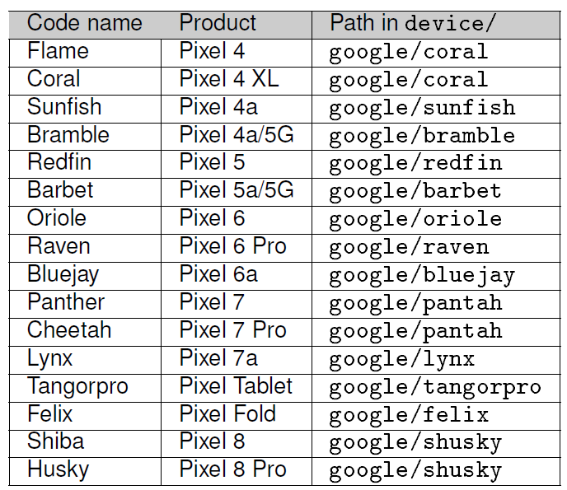
AOSP Devices: Pixel
Device configuration for Pixel handsets in U/14
Notes:
To map between Pixel handset and code name, look at https://source.android.com/setup/build/running
and https://developers.google.com/android/ota

Slide 106
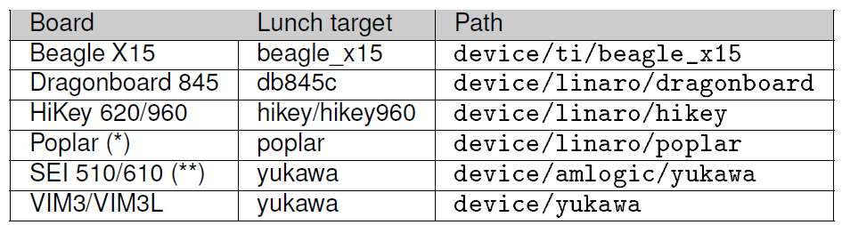
AOSP Devices: Dev Boards
Device configuration for Development boards in U/14
Notes:
https://source.android.com/setup/build/devices

Slide 107
Android Emulators
Notes:
emulator is a wrapper for the Quick EMUlator, QEMU
QEMU can emulate a variety of CPU architectures
AOSP ships these four:
64-bit ARM: qemu-system-aarch64
32-bit ARM: qemu-system-armel
64-bit x86: qemu-system-x86_64
32-bit x86: qemu-system-i386
You will find them in
prebuilts/android-emulator/linux-x86_64/qemu/linux-x86_64/ Goldfish
The Goldfish emulator has been part of Android since 1.6
Primarily for application testing, it was also used for platform testing until
Cuttlefish in P/9
The Goldfish runtime is called simply emulator
AOSP includes binaries for Linux:
Linux prebuilts/android-emulator/linux-x86_64/emulator
Android Studio has emulators for Windows and macOS, as well as Linux
Release notes for Emulator:
https://developer.android.com/studio/releases/emulator
Goldfish and Ranchu
Before L/5, emulated hardware was named Goldfish based on a forked copy
of QEMU version 1 - deprecated
Since L/5, the target is named Ranchu, based on a forked copy of QEMU
version 2
Note: this change has not been propagated consistently: "goldfish" still
appears in many of the build files, even though the real target is "ranchu"
The main difference between them is that "goldfish" supports obsolete goldfish-specific NAND and
eMMC virtual devices that are replaced by virtio-block in QEMU2 (for much better performance and
reliability)

Slide 108
Goldfish
well-known Android emulator, used for testing apps
usually installed along with Android Studio ...
... but also part of AOSP
Cuttlefish (since P/9)
used to test the Android operating system
more accurate emulation of real hardware
Notes:
Goldfish
The Goldfish emulator has been part of Android since 1.6
Primarily for application testing, it was also used for platform testing until
Cuttlefish in P/9
The Goldfish runtime is called simply emulator
AOSP includes binaries for Linux:
Linux prebuilts/android-emulator/linux-x86_64/emulator
Android Studio has emulators for Windows and macOS, as well as Linux
Release notes for Emulator:
https://developer.android.com/studio/releases/emulator
Goldfish and Ranchu
Before L/5, emulated hardware was named Goldfish based on a forked copy
of QEMU version 1 - deprecated
Since L/5, the target is named Ranchu, based on a forked copy of QEMU
version 2
Note: this change has not been propagated consistently: "goldfish" still
appears in many of the build files, even though the real target is "ranchu"
The main difference between them is that "goldfish" supports obsolete goldfish-specific NAND and
eMMC virtual devices that are replaced by virtio-block in QEMU2 (for much better performance and
reliability)

Slide 109
Goldfish and Ranchu
Before A-L/5, emulated hardware was named Goldfish based on a forked copy
of QEMU version 1 – deprecated
Since L/5, the target is named Ranchu, based on a forked copy of QEMU version 2
Note: this change has not been propagated consistently: "goldfish" still
appears in many of the build files, even though the real target is "ranchu"
Notes:
Goldfish
The Goldfish emulator has been part of Android since 1.6
Primarily for application testing, it was also used for platform testing until
Cuttlefish in P/9
The Goldfish runtime is called simply emulator
AOSP includes binaries for Linux:
Linux prebuilts/android-emulator/linux-x86_64/emulator
Android Studio has emulators for Windows and macOS, as well as Linux
Release notes for Emulator:
https://developer.android.com/studio/releases/emulator
Goldfish and Ranchu
Before L/5, emulated hardware was named Goldfish based on a forked copy
of QEMU version 1 - deprecated
Since L/5, the target is named Ranchu, based on a forked copy of QEMU
version 2
Note: this change has not been propagated consistently: "goldfish" still
appears in many of the build files, even though the real target is "ranchu"
The main difference between them is that "goldfish" supports obsolete goldfish-specific NAND and
eMMC virtual devices that are replaced by virtio-block in QEMU2 (for much better performance and
reliability)

Slide 110
Goldfish
Cuttlefish
Goldfish is the classic Android emulator that comes with Android Studio.
It is optimized for app developers—ideal for testing and developing Android apps.
It uses a QEMU-based emulator and supports typical AVD (Android Virtual Device) images for various Android versions.
Goldfish is easy to set up and runs on multiple host operating systems (Windows, macOS, Linux).
Limitations: Goldfish does not closely simulate all hardware behaviors. It is less suited for platform/deep OS development since it lacks high fidelity with real hardware and OS initialization (e.g., bootloader, HAL).
Cuttlefish is a newer, high-fidelity virtual device platform designed for AOSP and platform developers.
It closely replicates real hardware and is used for testing/customizing the Android OS itself (AOSP), not just apps.​
Runs as a virtual machine (using CrosVM or QEMU) and supports scalable, “cloud-friendly” use (can launch many instances for CI or large-scale testing).
Offers full compatibility with AOSP mainline development and is used by Google internally.
Designed to run only on Linux (usually Ubuntu), and the setup is more complex and resource-intensive.
Limitations: Not meant for typical app development workflows; intended mostly for system/framework development and validation.​

Slide 111
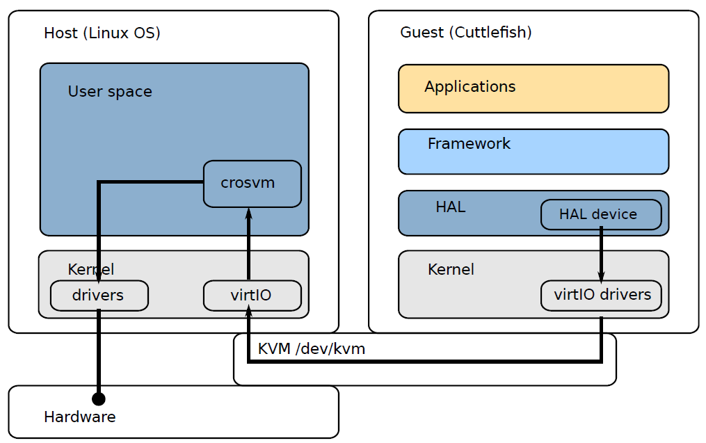
Cuttlefish
Headless: you communicate with it via ADB or remote desktop
Most I/O is via Linux virtio drivers (block, net, serial, gpu)
Uses crosvm (Chrome OS Virtual Machine Monitor) (*)
Uses Linux KVM (Kernel-based Virtual Machine) for hardware acceleration
(*) Earlier versions were based on QEMU
Notes:
https://source.android.com/setup/create/cuttlefish
Overview
Cuttlefish is a virtual Android device used mainly for development and testing. It doesn’t run on real hardware but on a host Linux machine that emulates the full Android stack — including HALs, framework, and apps — inside a guest virtual machine (VM).
Cuttlefish uses:
CrosVM (Chrome OS Virtual Machine) → runs the Android guest inside a virtualized sandbox.
KVM (/dev/kvm) → kernel-level hardware virtualization.
VirtIO → standardized communication between host and guest.
Architecture Breakdown
1. Host Side (Linux OS)
This is your workstation or CI server that launches the Android VM.
CrosVM - Virtual machine manager responsible for launching the guest, handling virtIO communication, and managing emulated devices (display, input, sensors, etc.). virtIO and standard drivers - Host kernel modules that expose virtualized hardware interfaces (virtIO block, net, GPU, input, etc.). Hardware—Real CPU, GPU, and I/O devices.
2. Guest Side (Cuttlefish / Android)
Inside the virtual machine — this is where Android OS actually runs.
virtIO drivers - Android kernel drivers that communicate with CrosVM’s virtIO backend. These replace physical hardware drivers. HAL device - Hardware Abstraction Layer adapted to use virtIO devices instead of real SoC peripherals (e.g., camera HAL using virtIO video). Framework—Standard Android framework layers — services, system server, etc. Applications—Normal Android apps, including system and test apps.
Data Flow Summary
Apps request hardware operations (e.g., open camera, play sound).
The Android Framework passes these to the HAL layer.
HAL communicates via virtIO drivers in the guest kernel.
virtIO sends the data through CrosVM using shared memory and I/O queues.
CrosVM interacts with host drivers or emulated backends.
The host uses actual hardware or a simulated device to complete the operation.
Results are sent back up the same path.
🔒 Role of KVM (/dev/kvm)
Provides hardware-assisted virtualization.
Allows the Android guest to execute directly on CPU (near-native speed).
Memory and I/O operations are trapped and handled by CrosVM.
/dev/kvm is the control device used by CrosVM to create and manage VMs.
🧩 VirtIO Overview
VirtIO is the bridge between host and guest. Each VirtIO device has:
Frontend driver (guest) — runs inside Android kernel.
Backend device (host) — handled by CrosVM.
Typical virtIO devices used by Cuttlefish:
virtio-net → network interface
virtio-block → virtual storage
virtio-gpu → virtual display
virtio-input → keyboard/touch
virtio-snd → audio
virtio-console → debug channel
🔍 CrosVM Responsibilities
CrosVM handles:
Setting up VM memory, CPU, and virtIO devices.
Interfacing virtIO devices with host hardware (GPU, audio, etc.).
Managing guest execution via KVM.
Providing communication channels between host tools and Android (ADB, logcat, etc.).
🧩 In Simple Terms
Host Kernel - Manages real hardware and provides virtIO backend support.
CrosVM - Virtual machine manager — bridges virtIO and KVM, runs Android guest.
Guest Kernel - Android’s kernel with virtIO frontend drivers.
HAL - Talks to virtIO devices instead of real hardware drivers.
Framework + Apps - Standard Android layers, unaware of virtualization.

Slide 112
Cuttlefish
Cuttlefish runs as a guest OS on Linux
Host and guest OS must be the same architecture, usually x86
These are the Cuttlefish targets for x86 and x86_64
aosp_cf_x86_64_foldable-userdebug
aosp_cf_x86_64_phone-userdebug
aosp_cf_x86_64_tv-userdebug
aosp_cf_x86_64_auto-userdebug
aosp_cf_x86_phone-userdebug
aosp_cf_x86_tv-userdebug
Note in previous slides the marvin device inherits from aosp_cf_x86_64_phone-userdebug
And marvincar device inherits from aosp_cf_x86_64_auto-userdebug
Notes:
Show cuttlefish demo
https://source.android.com/setup/create/cuttlefish
Overview
Cuttlefish is a virtual Android device used mainly for development and testing. It doesn’t run on real hardware but on a host Linux machine that emulates the full Android stack — including HALs, framework, and apps — inside a guest virtual machine (VM).
Cuttlefish uses:
CrosVM (Chrome OS Virtual Machine) → runs the Android guest inside a virtualized sandbox.
KVM (/dev/kvm) → kernel-level hardware virtualization.
VirtIO → standardized communication between host and guest.
Architecture Breakdown
1. Host Side (Linux OS)
This is your workstation or CI server that launches the Android VM.
CrosVM - Virtual machine manager responsible for launching the guest, handling virtIO communication, and managing emulated devices (display, input, sensors, etc.). virtIO and standard drivers - Host kernel modules that expose virtualized hardware interfaces (virtIO block, net, GPU, input, etc.). Hardware—Real CPU, GPU, and I/O devices.
2. Guest Side (Cuttlefish / Android)
Inside the virtual machine — this is where Android OS actually runs.
virtIO drivers - Android kernel drivers that communicate with CrosVM’s virtIO backend. These replace physical hardware drivers. HAL device - Hardware Abstraction Layer adapted to use virtIO devices instead of real SoC peripherals (e.g., camera HAL using virtIO video). Framework—Standard Android framework layers — services, system server, etc. Applications—Normal Android apps, including system and test apps.
Data Flow Summary
Apps request hardware operations (e.g., open camera, play sound).
The Android Framework passes these to the HAL layer.
HAL communicates via virtIO drivers in the guest kernel.
virtIO sends the data through CrosVM using shared memory and I/O queues.
CrosVM interacts with host drivers or emulated backends.
The host uses actual hardware or a simulated device to complete the operation.
Results are sent back up the same path.
🔒 Role of KVM (/dev/kvm)
Provides hardware-assisted virtualization.
Allows the Android guest to execute directly on CPU (near-native speed).
Memory and I/O operations are trapped and handled by CrosVM.
/dev/kvm is the control device used by CrosVM to create and manage VMs.
🧩 VirtIO Overview
VirtIO is the bridge between host and guest. Each VirtIO device has:
Frontend driver (guest) — runs inside Android kernel.
Backend device (host) — handled by CrosVM.
Typical virtIO devices used by Cuttlefish:
virtio-net → network interface
virtio-block → virtual storage
virtio-gpu → virtual display
virtio-input → keyboard/touch
virtio-snd → audio
virtio-console → debug channel
🔍 CrosVM Responsibilities
CrosVM handles:
Setting up VM memory, CPU, and virtIO devices.
Interfacing virtIO devices with host hardware (GPU, audio, etc.).
Managing guest execution via KVM.
Providing communication channels between host tools and Android (ADB, logcat, etc.).
🧩 In Simple Terms
Host Kernel - Manages real hardware and provides virtIO backend support.
CrosVM - Virtual machine manager — bridges virtIO and KVM, runs Android guest.
Guest Kernel - Android’s kernel with virtIO frontend drivers.
HAL - Talks to virtIO devices instead of real hardware drivers.
Framework + Apps - Standard Android layers, unaware of virtualization.

Slide 113
Steps to Install Cuttlefish Emulator

Slide 114
Step 1 :
Check if KVM is installed by checking for the existence of /dev/kvm, without it no emulator will work because Cuttlefish runs in a hypervisor domain
$ ls /dev/kvm
Step 2:
Download the cuttlefish emulator
$ cd ~/android/
$ sudo apt install -y git devscripts config-package-dev debhelper-compat golang curl
$ git clone https://github.com/google/android-cuttlefish
$ cd android-cuttlefish
$ git checkout 17ccfffd06139cd69d3b4cd4f0179b43b20aa573
$ for dir in base frontend; do cd $dir; debuild -i -us -uc -b -d; cd .. done
$ sudo dpkg -i ./cuttlefish-base_*_*64.deb || sudo apt-get install -f
$ sudo dpkg -i ./cuttlefish-user_*_*64.deb || sudo apt-get install -f
$ sudo usermod -aG kvm,cvdnetwork,render $USER
$ sudo reboot # NOTE => This last instruction will reboot your computer
Notes:
Download and setup the Cuttlefish tools (Original instruction at
https://android.googlesource.com/device/google/cuttlefish/):

Slide 115
Step 3 :
Launch cuttlefish with the WebRTC interface:
$ cd $HOME/aosp
$ launch_cvd -start_webrtc
Output ->
init: starting service 'adbd'...
VIRTUAL_DEVICE_DISPLAY_POWER_MODE_CHANGED
VIRTUAL_DEVICE_BOOT_STARTED
VIRTUAL_DEVICE_BOOT_COMPLETED
Virtual device booted successfully
NOTE ->
Cuttlefish GUI runs on port 8443
Launch a browser (must be Chrome or Chromium).
Enter URL https://0.0.0.0:8443

Slide 116
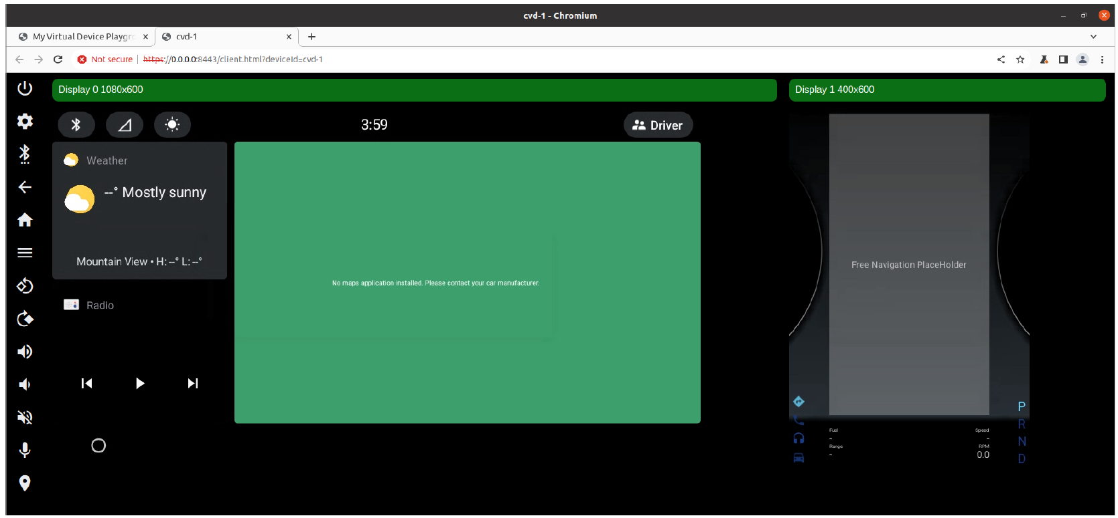
Notes:
Cuttlefish runs a CVD (Cuttlefish Virtual Device), similar to AVD for Goldfish
AOSP has these commands for manipulating CVDs
launch_cvd => start a CVD instance
cvd_status => status of running instances
stop_cvd => stop CVD instance

Slide 117
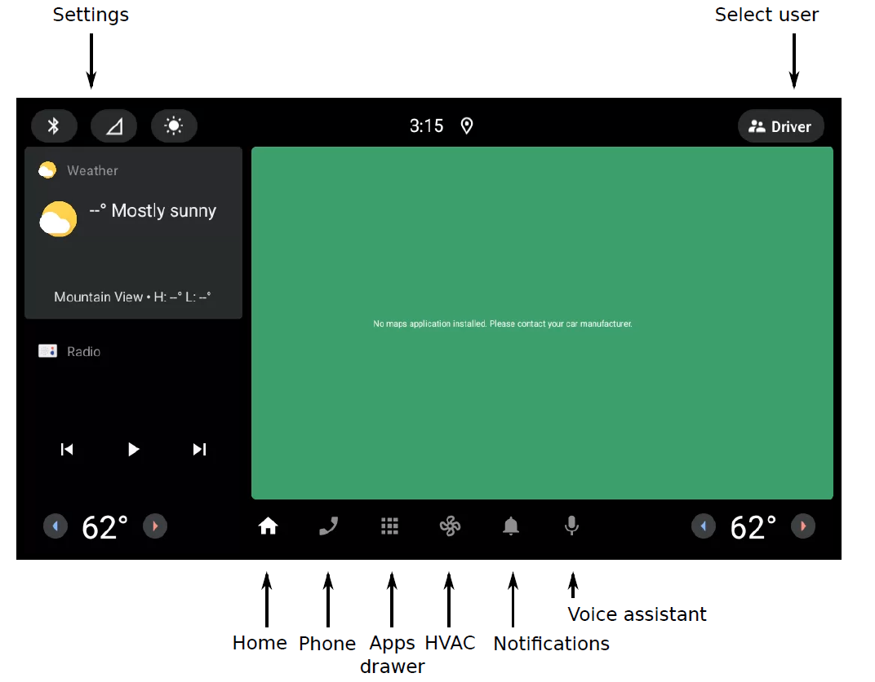
This is the default Automotive home screen for U/14

Slide 118
CVD STATUS
In another terminal, run lunch command again and then check if CVD is running:
$ cd $HOME/aosp
$ source and lunch
$ cvd_status
ADB
Check that there is an ADB device available. $ adb devices
$ adb shell
marvincar:/ $
Notes:
CVD (Cuttlefish Virtual Device)STATUS
In another terminal, run lunch command again and then check if CVD is running:
$ cd $HOME/aosp
$ source and lunch
$ cvd_status
Output example ->
cvd_status I 02-09 15:50:40 3561511 3561511 main.cc:130] Requesting status for
instance cvd-1
cvd_status I 02-09 15:50:40 3561511 3561511 main.cc:143] run_cvd is active for
instance cvd-1
3.3. Using ADB
Check that there is an ADB device available. You may need to run this command several
times before it shows up:
$ adb devices Output example ->
List of devices attached
0.0.0.0:6520 device
Now launch ADB:
$ cd $HOME/aosp
$ adb shell
marvincar:/ $

Slide 119
ADB and Logcat

Slide 120
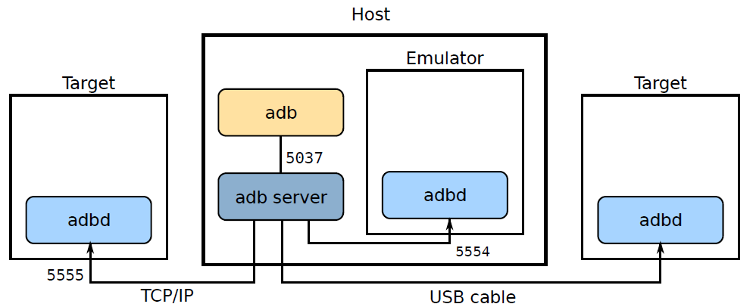
ADB Android Debug Bridge

Slide 121
ADB Android Debug Bridge Connection over USB
adb devices lists devices connected to the adb server
Each has a unique identifier or serial number
Pass this identifier when sending commands:
$ adb devices
List of devices attached
emulator-5554 device
199e5e2d device
$ adb -s emulator-5554 shell
NOTE
Don’t need -s device-name if
only one device
only one device connected via USB: use -d
only one emulator: use -e

Slide 122
ADB Android Debug Bridge (common issue)
$ adb devices
List of devices attached
???????????? no permissions
Run the command lsusb to find the vendor and product ids
$ lsusb
Bus 001 Device 002: ID 18d1:4e40 xxxxxxxxxxxxxxxxxxxxxxxxxxxxxxxxx
Add this rule to /etc/udev/rules.d/51-android.rules:
SUBSYSTEM=="usb", ATTR{idVendor}=="18d1", ATTR{idProduct}=="4e40", MODE="0666"
Then restart udev
$ sudo udevadm control --reload; sudo udevadm trigger
Notes:
Note: most Linux distros have pre-installed rules for common Android devices in
/lib/udev/rules.d/51-android.rules

Slide 123
ADB Android Debug Bridge Connection over TCP
adbd (on the device) listens on TCP port 5555
you can change the port with property service.adb.tcp.port
Connect from adb client using the IP address of the target device (if you know it), or using the name Android.local like this:
$ adb connect Android.local:5555
connected to 192.168.42.2:5555
$ adb shell
#
Notes:
Note: adbd uses DNS-SD (DNS Service Discovery) to broadcast an IP4 address for service "Android"

Slide 124
Starting the ADB server
The ADB server will be started when you run the first ADB client
Example
$ adb shell
* daemon not running; starting now at tcp:5037
* daemon started successfully
You can use these commands to control the server
adb start-server # ensure that there is a server running
adb kill-server # kill the server if it is running

Slide 125
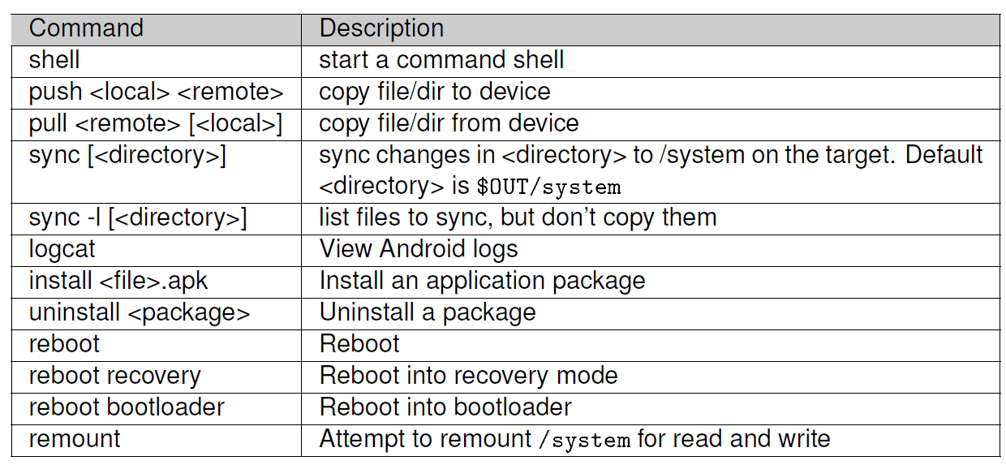
Useful ADB Commands

Slide 126
Logcat
The command logcat displays logs
The default format is
[timestamp] [PID] [TID] [Priority] [Tag]: [Message]
Example:
08-07 09:03:30.704 1565 1565 I ActivityManager: System now ready
Log Priority (starting with the highest)
S Silent
F Fatal
E Error
W Warning
I Information (default)
D Debug
V Verbose

Slide 127
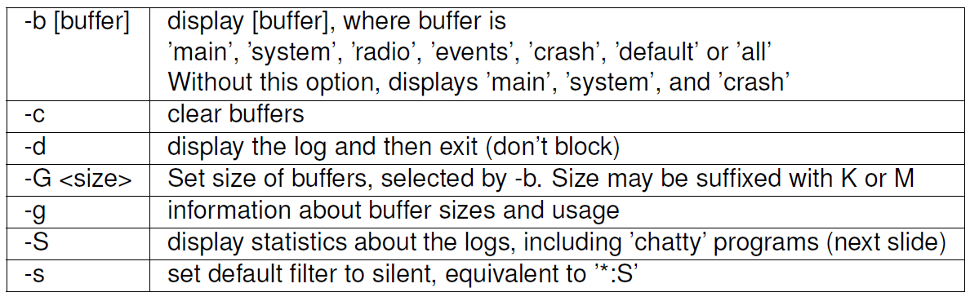
Useful Logcat Commands
logcat has many options: here are some that will be useful during this course

Slide 128
System Boot Flow

Slide 129
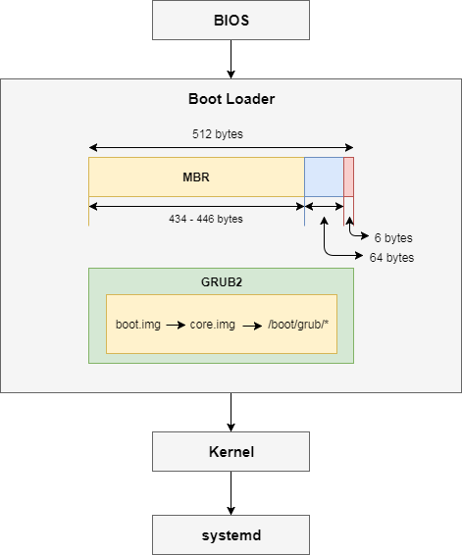
Linux PC / Ubuntu Booting Process
Notes:
BIOS
This is the first thing which loads once you power on your machine.
When you press the power button of the machine, CPU looks out into ROM for further instruction.
The ROM contains JUMP function in the form of instrucion which tells the CPU to bring up the BIOS
BIOS determines all the list of bootable devices available in the system.
Prompts to select bootable device which can be Hard Disk, CD/DVD-ROM, Floppy Drive, USB Flash Memory Stick etc (optional)
Operating System tries to boot from Hard Disk where the MBR contains primary boot loader.
Boot Loader
To be very brief this phase includes loading of the boot loader (MBR and GRUB/LILO) into memory to bring up the kernel.
MBR (Master Boot Record)
It is the first sector of the Hard Disk with a size of 512 bytes.
The first 434 - 446 bytes are the primary boot loader, 64 bytes for partition table and 6 bytes for MBR validation timestamp.
NOTE: Now MBR directly cannot load the kernel as it is unaware of the filesystem concept and requires a boot loader with file system driver for each supported file systems, so that they can be understood and accessed by the boot loader itself.
To overcome this situation GRUB2 is used with the details of the filesystem in /boot/grub2/grub.cfg and file system drivers.
GRUB2
Its function is to take over from BIOS at boot time, => then load itself, => load the Linux kernel into memory, => and then turn over execution to the kernel.
Once the kernel takes over, => GRUB has done its job and it is no longer needed.
GRUB supports multiple Linux kernels and allows the user to select between them at boot time using a menu.
So you can choose between various kernel or failover kernel if the primary one does not works.
The /boot/grub2/grub.cfg file is the GRUB configuration file.
It is generated by the grub2-mkconfig program using a set of primary configuration files and the grub default file as a source for user configuration specifications from /etc/sysconfig/grub.
The /boot/grub2/grub.cfg file is first generated during Linux installation and regenerated when a new kernel is installed.
To check the GRUB2 version used
# grub2-install -V grub2-install (GRUB) 2.02~beta2 With legacy GRUB we had thre different stages i.e. Stage 1 -> Stage 1.5 -> Stage 2 But with GRUB2 these stages do not exist anymore instead GRUB2 contain various *.img files as explained below
boot.img On PC BIOS systems, this image is the first part of GRUB to start. It is written to a master boot record (MBR) or to the boot sector of a partition. Because a PC boot sector is 512 bytes, the size of this image is exactly 512 bytes.
The sole function of boot.img is to read the first sector of the core image from a local disk and jump to it. Because of the size restriction, boot.img cannot understand any file system structure, so grub-install hardcodes the location of the first sector of the core image into boot.img when installing GRUB.
core.img This is the core image of GRUB. It is built dynamically from the kernel image and an arbitrary list of modules by the grub-mkimage program. Usually, it contains enough modules to access /boot/grub, and loads everything else (including menu handling, the ability to load target operating systems, and so on) from the file system at run-time. The modular design allows the core image to be kept small, since the areas of disk where it must be installed are often as small as 32KB.
Once executed, core.img will load its configuration file and any other modules needed, particularly file system drivers at installation time based on the location using which the system is getting booted as explained below
diskboot.img This image is used as the first sector of the core image when booting from a hard disk. It reads the rest of the core image into memory and starts the kernel. Since file system handling is not yet available, it encodes the location of the core image using a block list format.
cdboot.img This image is used as the first sector of the core image when booting from a CD-ROM drive. It performs a similar function to diskboot.img.
pxeboot.img This image is used as the start of the core image when booting from the network using PXE. See Network.
lnxboot.img This image may be placed at the start of the core image in order to make GRUB look enough like a Linux kernel that it can be booted by LILO using an ‘image=’ section.
kernel.img This image contains GRUB’s basic run-time facilities: frameworks for device and file handling, environment variables, the rescue mode command-line parser, and so on. It is rarely used directly, but is built into all core images.
Last Stage
At this point GRUB2 loads the selected kernel into memory and turns control of the computer over to the kernel.
If files or the partition become unavailable, or if the user wishes to take direct control, stage 2 will drop the user to the GRUB command prompt, where the user can then manually specify the boot parameters.
Kernel
The kernel files are present inside /boot directory along with an initial RAM disk image, and device maps of the hard drives.

Slide 130
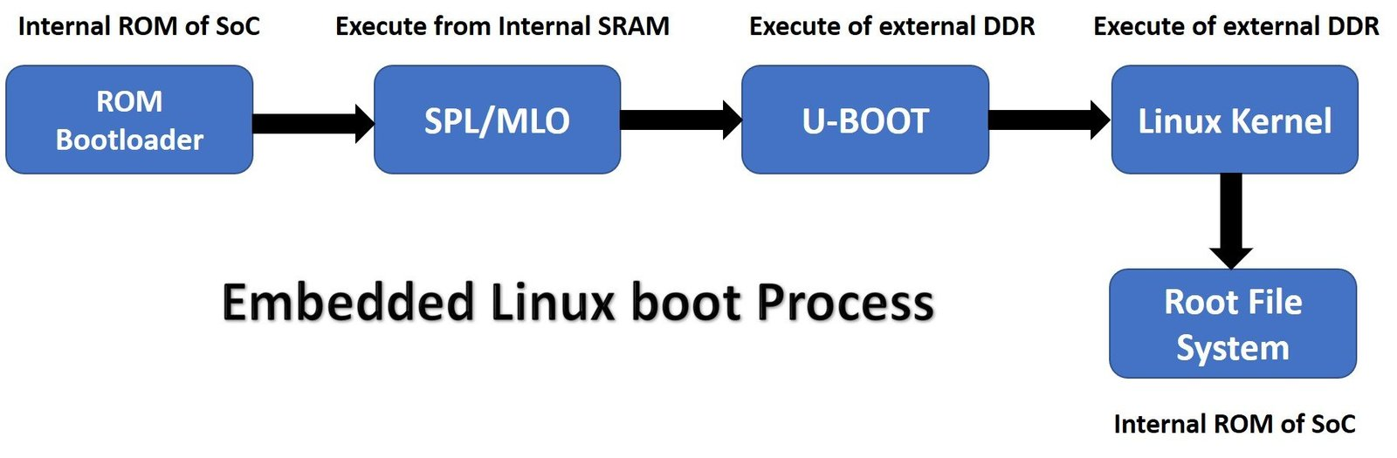
Embedded Linux Booting Process

Slide 131
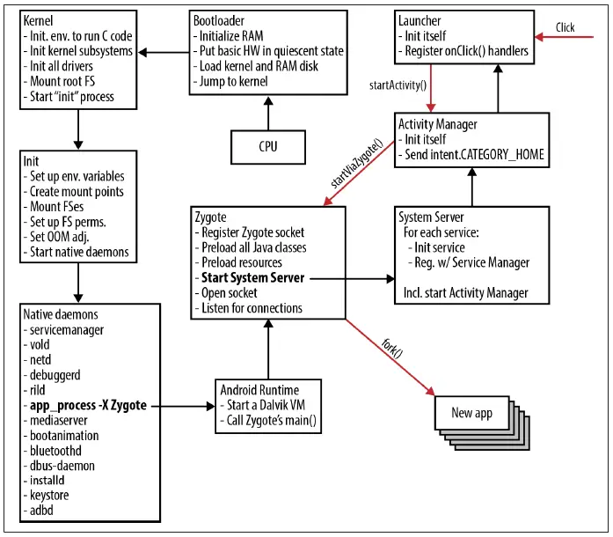
Android Booting Process
Notes:
Android Booting Sequence (Step-by-Step)
1. Bootloader
The bootloader executes immediately after the SoC’s ROM code.
Responsibilities:
Initialize RAM, clock, and minimal peripherals.
Load the Linux kernel and ramdisk (initrd) into RAM.
Pass hardware info to the kernel via the device tree blob (DTB) or ATAGs.
Jump to the kernel’s entry point.
Typical files: boot.img → [kernel + ramdisk + DTB].
In Android, bootloader phases:
Primary bootloader (PBL) → minimal hardware init.
Secondary (SBL / ABL) → verifies signature, loads kernel image.
2. Kernel Initialization
The kernel is now running.
Actions performed:
Initialize low-level subsystems (MMU, scheduler, interrupts).
Initialize device drivers (UART, display, storage, etc.).
Mount the root filesystem (from the ramdisk).
Start the first user-space process → /init.
🧠 Think of this as “bringing up the Linux world” so that Android services can run.
3. Init Process
Binary: /init (from ramdisk).
Responsibilities:
Parse init.rc and other .rc scripts (like init.${ro.hardware}.rc).
Create mount points and mount partitions (system, vendor, data).
Set system properties, ulimit, OOM priorities.
Start native daemons such as:
servicemanager
vold (volume daemon)
netd (network)
rild (radio interface layer daemon)
mediaserver, surfaceflinger, etc.
Launch the Zygote process (via app_process -Xzygote).
Essentially, init is the Android equivalent of Linux’s systemd or SysV init.
4. Zygote Process
Zygote is the parent process of all Android apps.
Binary: /system/bin/app_process
Steps:
Starts the Android Runtime (ART) or Dalvik VM.
Preloads Java classes, resources, and framework components to save memory.
Opens a socket and waits for commands from the Activity Manager Service.
Spawns the System Server thread via startSystemServer().
Zygote drastically reduces app launch time by forking pre-initialized processes.
5. System Server
Runs inside a dedicated Java process created by Zygote.
Responsibilities:
Starts all core Android system services:
ActivityManagerService
PackageManagerService
WindowManagerService
PowerManagerService
AudioService, InputManagerService, etc.
Registers them with the Service Manager for IPC via Binder.
After this, the Android framework layer (Java) is ready.
At this stage, the Android OS framework is fully alive.
6. Activity Manager
The ActivityManagerService (AMS) controls:
App/process lifecycle (start/stop/resume).
Task stacks and activities.
Communication between apps and system.
After System Server starts, AMS sends an intent → CATEGORY_HOME → to start the Launcher app (the home screen).
7. Launcher App
The launcher (home screen) is just a normal Android app registered for android.intent.category.HOME.
Tasks:
Initializes itself and UI.
Displays installed apps.
When you tap an app icon, Launcher calls startActivity(), which tells AMS to fork a new app process from Zygote.
8. Application Start (Zygote Fork)
AMS instructs Zygote to fork a new process.
Zygote → fork() → New app process
New app gets its own Dalvik/ART VM instance.
Loads the target app’s code (classes.dex) and resources.
Calls Application.onCreate(), then launches the activity.
In Modern Android (A12–A15)
Uses ART (Android Runtime) — replaces Dalvik.
Treble architecture separates system/vendor partitions.
Uses system_ext and product partitions for modularization.
init uses rc import directives (e.g., /vendor/etc/init).
Zygote64 / Zygote32 — dual architecture for 64-bit and 32-bit processes.
SystemServer starts via ZygoteInit.main() → RuntimeInit → SystemServer.main().

Slide 132
Difference Between Classic Android (Android 4.x → 10)
vs Modern Android (Android 12 → 15)

Slide 133
Category | Classic Android (Android 4.x → 10) | Modern Android (Android 12 → 15)
Architecture | Monolithic & device-specific Android stack tightly coupled with hardware. | Modular, Treble-compliant architecture separating system and vendor layers for independent updates.
Partition Layout | Only a few fixed partitions: /boot, /system, /vendor, /userdata. | Dynamic Partitions: /system, /vendor, /product, /system_ext, /vendor_dlkm, /odm_dlkm, enabling flexible OTA updates.
Boot Image Format | boot.img contained kernel + ramdisk + DTB. | boot.img + vendor_boot.img introduced (contains vendor ramdisk + DTBO).
Boot Verification | Basic Verified Boot (AVB 1.0) or dm-verity; OEM-defined verification flow. | AVB 2.0 with rollback protection and complete chain-of-trust from Boot ROM → vbmeta → partitions.
Kernel Model | Per-device kernel tree (OEM customized heavily). | Generic Kernel Image (GKI 2.0) — common base kernel maintained by Google + vendor-specific modules (vendor_dlkm).
Kernel Modules | Mostly built-in or statically compiled. | Split into generic (system_dlkm) and vendor (vendor_dlkm) loadable modules.
Hardware Abstraction Layer (HAL) | Based on HIDL (C++/binderized XML interfaces). | Migrated to AIDL-based HALs for stability and backward compatibility (from A12 onward).
Init System | Single /init.rc script with device-specific rc extensions. | Modular init configuration — partition-specific init rc files: /system/etc/init/, /vendor/etc/init/, /product/etc/init/.
Zygote | Single 32-bit Zygote; spawns SystemServer and app processes. | Dual Zygote model (Zygote64 and Zygote32) to handle mixed 32/64-bit apps. Runs under strict SELinux domain.
Runtime (VM) | Dalvik VM (JIT only). | ART (Android Runtime): AOT + JIT hybrid, per-app compilation, better performance and power efficiency.
System Services | Started by SystemServer, but all defined under /system only. | Services distributed across partitions (system, system_ext, vendor, product) using stable AIDL/Binder interfaces.
Security & SELinux | SELinux optional or permissive. | SELinux enforced by default (Android 12+) with strict sandboxing and namespace separation.
Binder IPC | Single global binder space. | Isolated Binder contexts (e.g., vendor binder vs system binder) to separate vendor processes from framework.
Storage Access | Legacy filesystem permissions; global storage access. | Scoped Storage model — apps restricted to sandboxed directories.

Slide 134
Category | Classic Android (Android 4.x → 10) | Modern Android (Android 12 → 15)
Graphics Stack | SurfaceFlinger monolithic, vendor-dependent EGL/GL drivers. | Modular HWC3 + Gralloc4 interfaces, vendor composition through AIDL HALs.
Audio Stack | AudioFlinger & Audio HAL (legacy HIDL). | AIDL Audio HAL + Volume Group HAL + policy modularization introduced.
Connectivity Stack | Native daemons like netd, wpa_supplicant, etc. | Modularized network stack: NetworkStack.apk as a privileged mainline module.
Update Mechanism | OTA update replaces entire system image (downtime, risk). | Seamless A/B updates, Dynamic Partitions, and snapshot merges for near-zero downtime updates.
Vendor Dependence | OEM had to rebuild full image for every Android upgrade. | Vendor can reuse binary blobs; only framework image needs updating (thanks to Treble).
Treble Support | Not available (pre-A8). | Fully Treble-compliant; HALs must be versioned and stable.
Mainline Modules (Project Mainline) | Not supported. | Project Mainline → Core components (Media, NNAPI, Conscrypt, etc.) updatable via Google Play (APEX modules).
Virtualization Support | None (baremetal). | Introduced pKVM / Cuttlefish / Crosvm — secure virtualization for Android on Arm64 and x86.
Performance Class / Device Policy | Not defined formally. | Defined Performance Classes (PC13, PC14, PC15) to ensure predictable app experience tiers.
Developer Images | Full system rebuild required for testing. | GSI (Generic System Image) can boot on any Treble-compliant device for validation.
Power Management | Device-specific Power HALs. | AIDL Power HAL 3.0 with adaptive thermal + performance hinting APIs.
Display / Multi-Display Support | Basic single-display support. | Extended multi-display and automotive display stack (CarDisplayService, DisplayArea policy).
Automotive (AAOS) | Framework integrated with main Android image. | Independent AAOS architecture (separate CarService, VHAL, VHAL Binder interface).
Security Updates | OEM + carrier dependent. | Modular APEX + Mainline ensures monthly framework & kernel security patches from Google.

Slide 135
The Android partition table

Slide 136
Classic Android Partition Roles (Pre-A/B)
Partition Name | Mounted Path / Use | What It Contains | Purpose / Why Needed
bootloader | N/A | Low-level boot code (PBL/SBL/LK/U-Boot/ABL) | Initializes DRAM, clocks, verifies signature, loads kernel. Essential for boot chain.
boot | - | Kernel + Ramdisk + DTB (packaged as boot.img) | Contains the Linux kernel and initial ramdisk. The device boots from here into user space (/init).
system | /system | Framework, Android OS binaries, default apps | Holds core Android framework, libraries, and system apps (Settings, Launcher, etc.).
vendor | /vendor | HAL binaries, device-specific libs, firmware | OEM/vendor-specific drivers and HALs needed for the SoC and peripherals. Decouples BSP from system image.
data | /data | User data, installed apps, app data, cache | Stores everything belonging to the user. Wiped during factory reset.
cache | /cache | Temporary OTA and Dalvik cache data | Used by OTA updater and app runtime cache (obsolete in newer Android).
recovery | Bootable image (alternate boot path) | Mini Linux + recovery app (UI + update tools) | Used to factory reset or flash updates manually (Volume+Power boot).
misc | N/A | Boot flags, reboot reason, etc. | Small config area used by bootloader and recovery to communicate (boot modes).
radio / modem | N/A | Modem firmware blobs | Stores baseband firmware for cellular modem.
persist | /persist | Factory calibration data (Wi-Fi, camera, sensors, IMEI) | Holds non-volatile data that must survive factory reset.
dtbo | - | Device Tree Overlays | Hardware configuration overrides used at boot.
vbmeta | - | AVB metadata and verification keys | Used by Android Verified Boot (AVB 2.0) for integrity checks.

Slide 137
A/B (Seamless Update) Partition Scheme (Android 7–10)
Partition | Purpose | How It Works in A/B
boot_a / boot_b | Kernel + ramdisk | Device runs from current slot (say _a); OTA flashes new image into inactive slot (_b).
system_a / system_b | Android framework | Seamless OTA: after update, bootloader switches slot.
vendor_a / vendor_b | HAL + BSP | Each slot carries matching vendor libs for its system image.
product_a / product_b | Optional partition for OEM apps | Also duplicated for A/B safety.
vbmeta_a / vbmeta_b | Verification metadata | Ensures chain of trust for each slot.
userdata | Common (non-A/B) | Shared, not duplicated — user data persists.
NOTE => A/B system means two sets of partitions → “slot A” and “slot B”.
Why introduced:
To avoid update failures or “bricks”.
If update on slot _b fails, bootloader keeps using _a (safe rollback).

Slide 138
Dynamic Partitions (Android 10+)
Dynamic partitions were introduced to remove hard-coded partition sizes and enable resizing during OTA.
A new super partition wraps logical partitions:
super -> [ system_a, vendor_a, product_a, system_ext_a, odm_a, ... ]
Logical partitions behave like real ones but are stored in one big container.
lpmake tool manages creation and resizing.
Managed by update_engine during OTA.
Why Dynamic Partition -
Easier OTA without reflashing partition tables.
Future-proof (OEM can add/remove logical partitions).
Enables Google’s modular architecture (Project Treble).

Slide 139
Modern Android (A12–A15) Storage Layout
Partition | What It Does (Modern Android) | Notes
boot | Contains kernel + ramdisk for GKI | Verified by AVB chain. May include recovery-ramdisk (recovery merged).
vendor_boot | Vendor-specific ramdisk + DTBO | Allows vendor init scripts and kernel modules to load separately from system.
vbmeta / vbmeta_system / vbmeta_vendor | AVB metadata and keys | Provide verified-boot chain per partition group.
system | Core Android framework (/system) | GSI / framework layer. Now purely generic.
system_ext | OEM’s extension to /system | For partially customized framework or settings.
product | Product-specific apps and overlays | OEM UI, apps, and themes.
vendor | HALs, device drivers, firmware | Contains vendor AIDL/HIDL HALs and binary blobs.
vendor_dlkm | Vendor loadable kernel modules | Supports GKI 2.0 modularization.
odm / odm_dlkm | Optional device modules | For ODM-level (board-specific) HALs or modules.
data | User data partition | Apps, settings, user content. File-based encryption mandatory.
metadata | AVB metadata, encryption keys, OTA metadata | Used for verified boot, FBE, and OTA state tracking.
super | Logical container for dynamic partitions | Holds system/vendor/product/system_ext, resizable.
persist | Calibration, Wi-Fi MAC, camera lens data | Non-volatile, preserved through OTA/factory reset.
misc | Bootloader <-> Android message area | Reboot reason, recovery command flags.
recovery (optional) | Recovery ramdisk (if not merged) | On modern devices, merged into boot/vendor_boot.

Slide 140
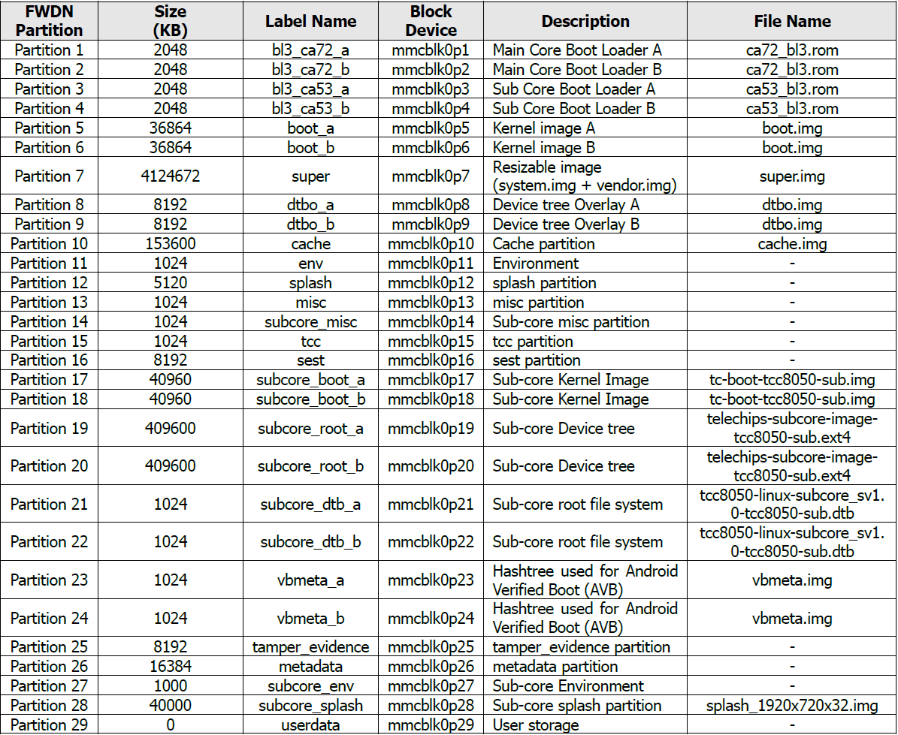
Partition Information for TCC805x EVB
Note: Partitions (vbmeta, tamper_evidence, and metadata) are used for Android Verified Boot (AVB).
■ For more details, refer to https://android.googlesource.com/platform/external/avb/+/master/README.md.

Slide 141
Practice
Telechip build, and flash step
A14 Android build, and flash step
A14 AAOSP Demo with Emulator

Slide 142
Q & A

Slide 143
Thank you

Slide 144
The Android Framework

Slide 145
The Android Framework Agenda
Take a look at the Android framework
Look at how managers and system services communicate
Defining interfaces using AIDL
Outline implementation of a system service
Deploying system services in applications
How to call services from the command-line

Slide 146
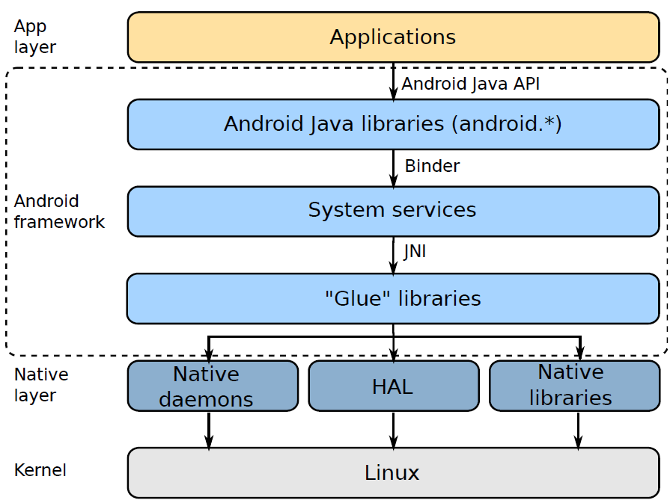
Architecture

Slide 147
Android Framework layer
Android Java libraries
implement the Android API
have the same privilege as the calling app
System Services
a collection of objects that make up the Android operating system
run in different process to the app
have elevated privileges
enforce the Android permissions
"Glue" libraries
connect system services (written mostly in Java) to the native layer

Slide 148
System Services
The framework implements an object-oriented operating system on top of a conventional Unix-like operating system (Linux).
Object-oriented means a collection of services that can be invoked remotely.
Services perform system-level tasks on behalf of the caller, e.g.:
Making the device vibrate (VibratorService)
Managing power states (PowerManager)
Managing activity state (Activity Manager)
Services use system UIDs that allow them to access system resources
There are several tools that can be used to monitor and interact with system services

Slide 149
System Services
• Listing the main system services:
# service list
• Listing vendor system services (may not be built by default on Cuttlefish):
# vndservice list
• Finding out what process is running the main system server process:
# ps -A | grep system_server
• Dumping the internal state of all system services:
# dumpsys

Slide 150
System Services
• Dumping the internal state of a single system service (Activity Manager in this case):
# dumpsys activity
• Checking the logs for the system server process’ PID (replace [] value):
# logcat --pid=[PID RETURBED BY PS COMMAND ABOVE]
• Checking the logs for output from a given system service – WindowManager for ex:
# logcat | grep -i windowmanager
• Communicate with the activity manager:
# am
• Communicate with the package manager:
# pm
• Communicate with the window manager:
# wm

Slide 151
Google’s flavours of Android

Slide 152
There are several variants of Android in AOSP
In each case, Google licenses optional proprietary services that connect to
Google back end servers
Android variant | Optional proprietary services
Smartphone and Tablet | GMS - Google Mobile Services
TV | GTVS - Google TV services
Automotive | GAS - Google Automotive Services
There is also Wear OS for smart watches, but very little of the support is in AOSP

Slide 153
Binder
Binder is the mechanism that connects the client with the server
We call the client a manager
And the server a service 1
Binder messages are called parcels
A parcel contains the credentials (UID and PID) of the client
Size of a parcel is limited to 1 MiB
Interfaces are defined in AIDL (Android Interface Definition Language)

Slide 154
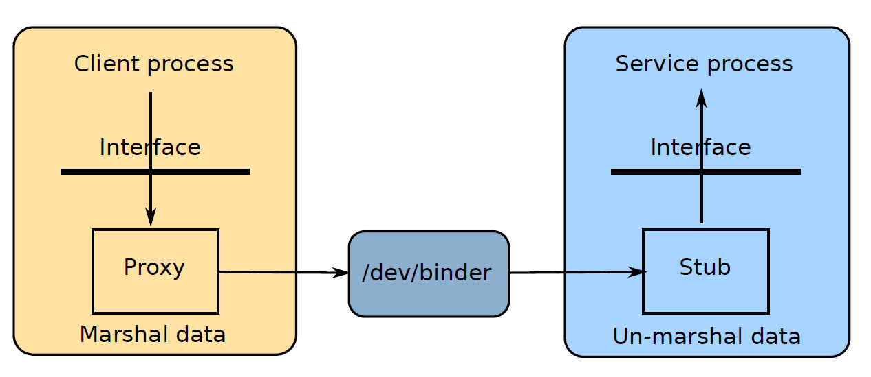
Remote invocation
Remote invocation of a method on the service is achieved using a proxy in the client and a stub in the service
The data elements are marshalled (serialized) in the proxy and unmarshalled in the stub

Slide 155
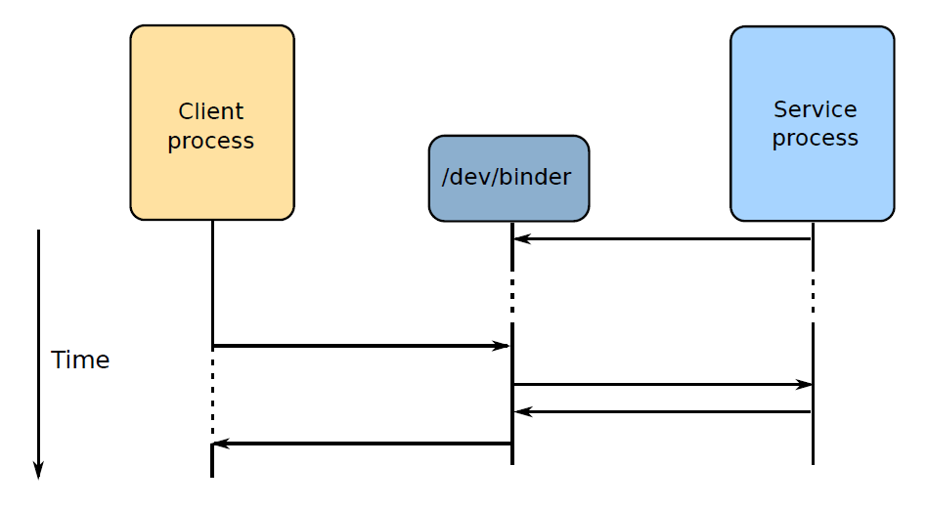
Control flow
Parcels generated by the manager (client) are routed via binder to the service

Slide 156
AIDL

Slide 157
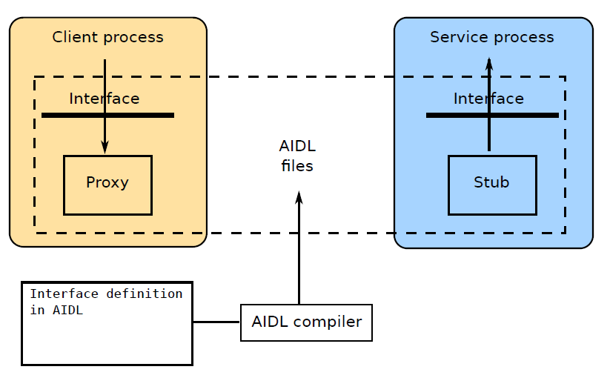
AIDL
The Android Interface Definition Language takes care of creating the code for the proxy and stub for system services written in Java

Slide 158
AIDL language
AIDL is "Java-like“
Example: part of IPowerManager.aidl
package android.os;
import android.os.WorkSource;
import android.os.PowerSaveState;
interface IPowerManager {
[...]
boolean isInteractive();
boolean isPowerSaveMode();
PowerSaveState getPowerSaveState(int serviceType);
boolean setPowerSaveMode(boolean mode);
boolean isDeviceIdleMode();
boolean isLightDeviceIdleMode();
[...]
}
https://source.android.com/devices/architecture/aidl/overview

Slide 159
Call semantics
By default, calls are synchronous
Declare a method oneway to make it asynchronous
Example: from IPowerManager.aidl
[...]
interface IPowerManager {
[...]
oneway void powerHint(int hintId, int data);
[...]
A oneway call does not block, it simply sends the parcel and returns immediately
The implementation of the interface receives this as a regular call from the Binder thread pool

Slide 160
AIDL data types
Simple types: boolean, char, int, long, float
String
CharSequence
Objects that implement the Parcelable interface
writeToParcel: writes the current state of the object to a parcel
readFromParcel: sets the state from a parcel
Objects are passed by reference and must be marked in AIDL as in, out or inout, e.g.
boolean setAdaptivePowerSavePolicy(in BatterySaverPolicyConfig config);

Slide 161
Compiling AIDL
The aidl compiler takes the interface definition and generates two classes
Proxy: same name as the interface (e.g. IPowerManager)
Stub: named [interface].Stub, e.g. (IPowerManager.Stub)
Use the proxy when writing the manager
Use the stub for the service
Since O/8 you can generate C++ bindings using aidl-cpp. See
system/tools/aidl/docs/aidl-cpp.md for details

Slide 162
Example: SimpleManager
Define the interface, ISimpleManager.aidl
package com.example.simplemanager;
interface ISimpleManager {
int addInts (int a , int b);
String echoString (String s);
}
Generates classes
manager proxy: ISimpleManager
service stub: ISimpleManager.Stub

Slide 163
Implementing the service
Extend AIDL-generated stub class ISimpleManager.Stub and implement the interface
Methods
ISimpleServiceImpl.java
package com.example.simpleservice;
import com.example.simplemanager.ISimpleManager;
class ISimpleServiceImpl extends ISimpleManager.Stub {
public int addInts(int a, int b) {
return a + b;
}
public String echoString(String s) {
return s;
}
}

Slide 164
HIDL

Slide 165
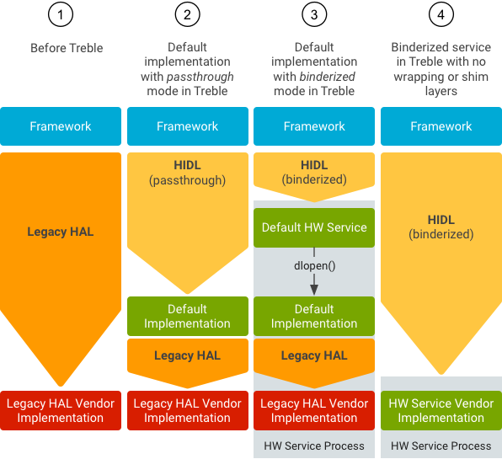

Slide 166
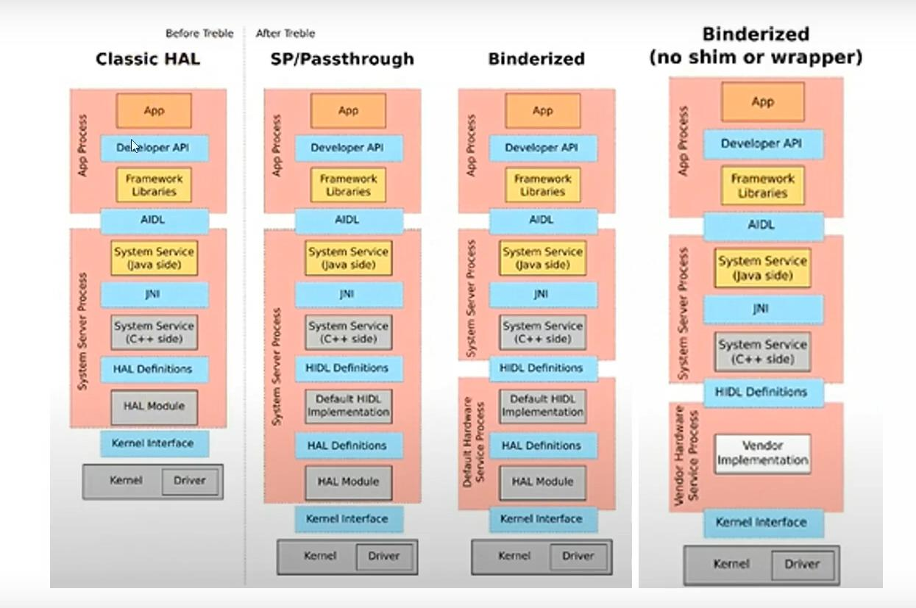

Slide 167
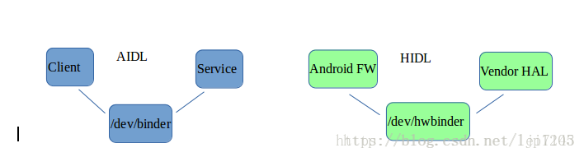
AIDL vs HIDL

Slide 168
Practice :- AIDL and HIDL Example

